Slide 1
FutureQual: How To Keep ARL Rankings Relevant
Adam Siegel
UC Davis
25 October 2013

Slide 2
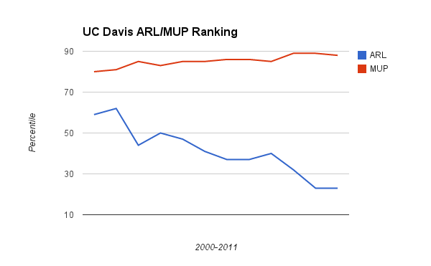

Slide 3
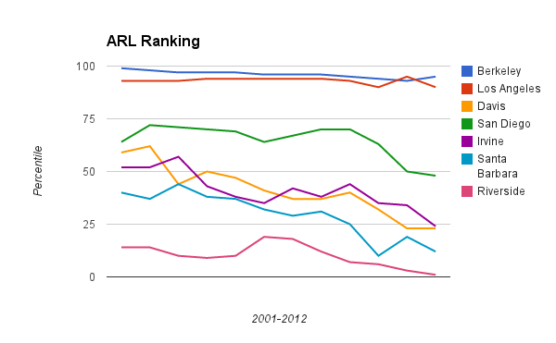

Slide 4
“According to most recent reports, Penn State University Libraries rank among the top-ten North American research libraries, based on Association of Research Libraries (ARL) Library Investment Index Rankings for 2010-2011.” (“Penn State Libraries rank among the top 10,” http://news.psu.edu, 10 Sep 2012)

Slide 5
“According to most recent reports, Penn State University Libraries rank among the top-ten North American research libraries, based on Association of Research Libraries (ARL) Library Investment Index Rankings for 2010-2011.” (“Penn State Libraries rank among the top 10,” http://news.psu.edu, 10 Sep 2012)
“Attain a ranking in the top 50 of Association of Research Libraries.” Texas Tech University Libraries Strategic Plan (http://library.ttu.edu/about/admin/strategic_plan.php)

Slide 6
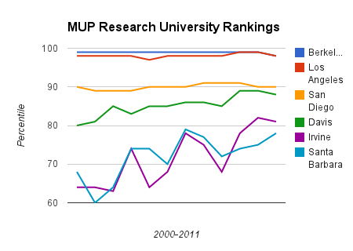

Slide 8
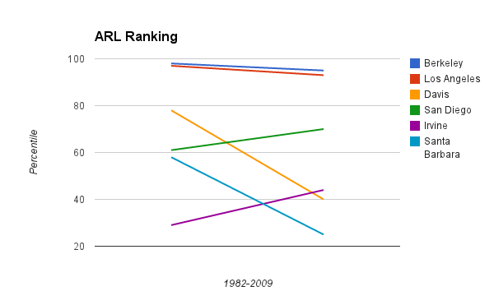

Slide 9
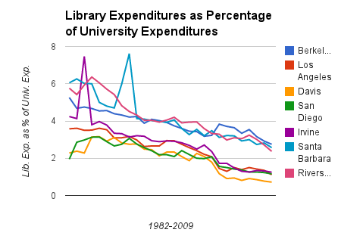

Slide 11
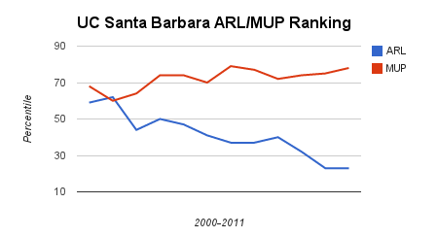

Slide 12
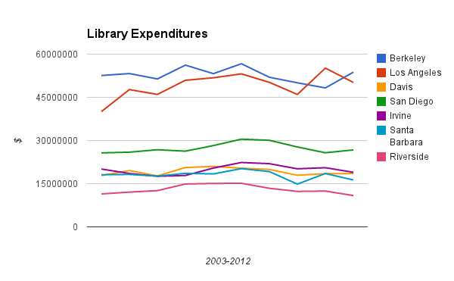

Slide 13
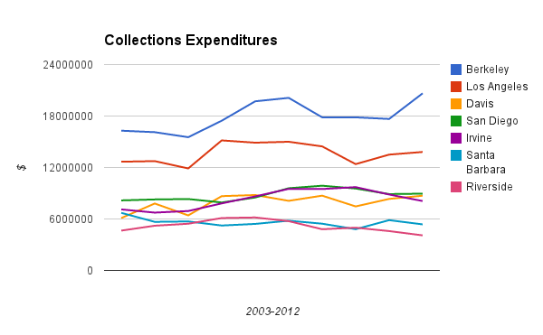

Slide 16
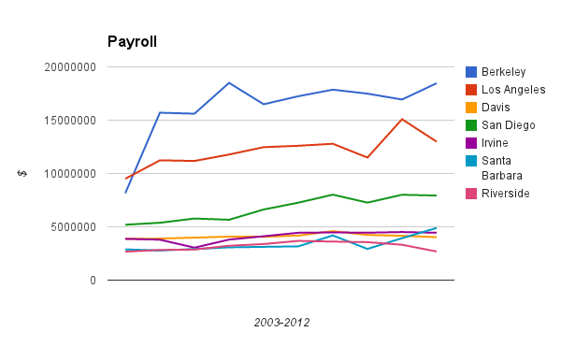

Slide 17
FutureQual: How To Keep ARL Rankings Relevant
Adam Siegel
UC Davis
25 October 2013

