Slide 1
Evaluation and Assessment of Library Services
Lyn Paleo, MPA, DrPH
Evaluation Manager
Making It Count
October 25, 2013

Slide 2
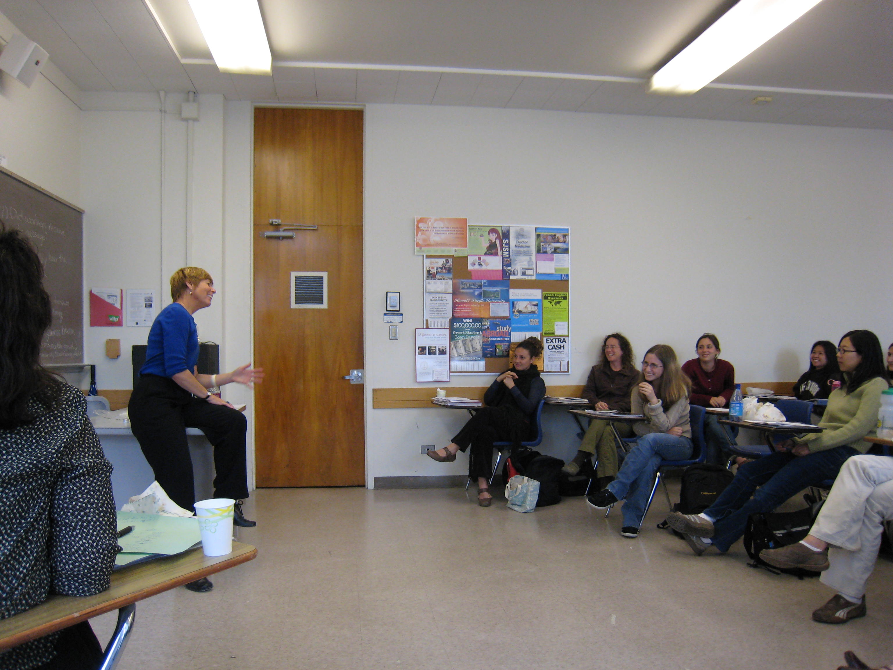

Slide 4
Part I: Evaluation
Identifying outcomes

Slide 5
The Library as an Intervention
Problem or need
Intervention
Outcomes
Impact
(program, policy, service, institution, etc)

Slide 6
The Library as an Intervention
How is the intervention supposed to work?
Do the outcomes occur, and for whom?
What is the problem?
Problem or need
Intervention
Outcomes
Impact
(program, policy, service, institution, etc)

Slide 7
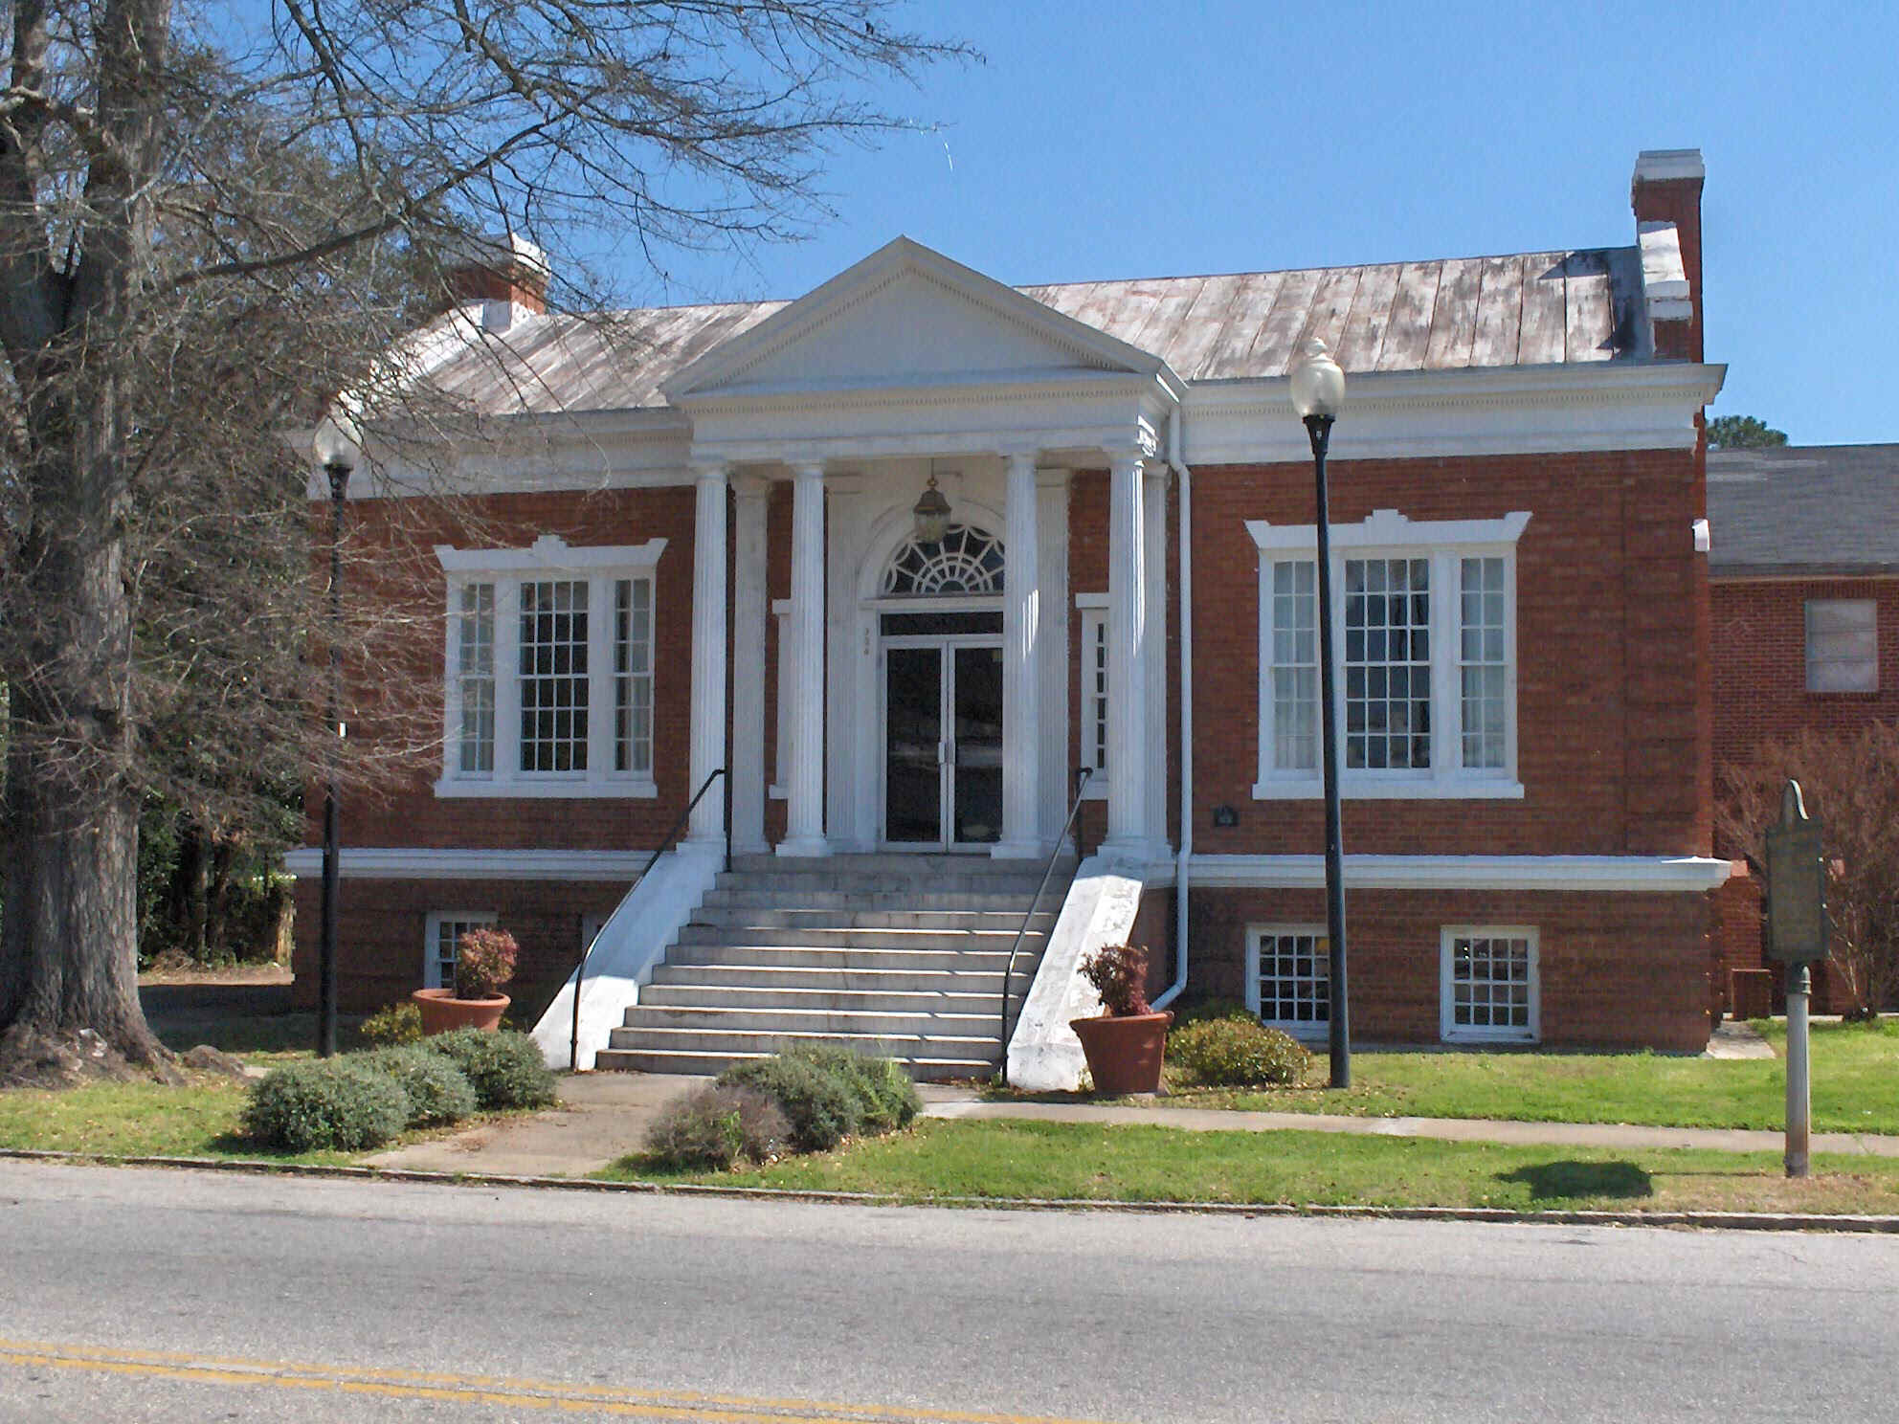
Libraries: What good are they?

Slide 8
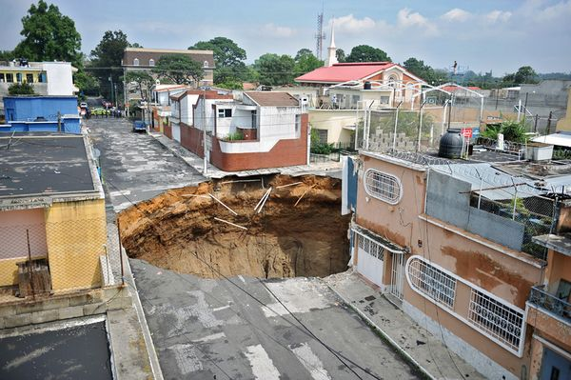
What if they sank into the ground?

Slide 9
Libraries : What problem do they address?
Students: ____________
Faculty: _____________
University: ___________
Problem or need
Intervention
Outcomes
Impact

Slide 10
Libraries: An intervention
Intervention
Problem
or need
Outcomes
Impact

Slide 11
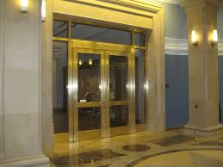

Slide 12
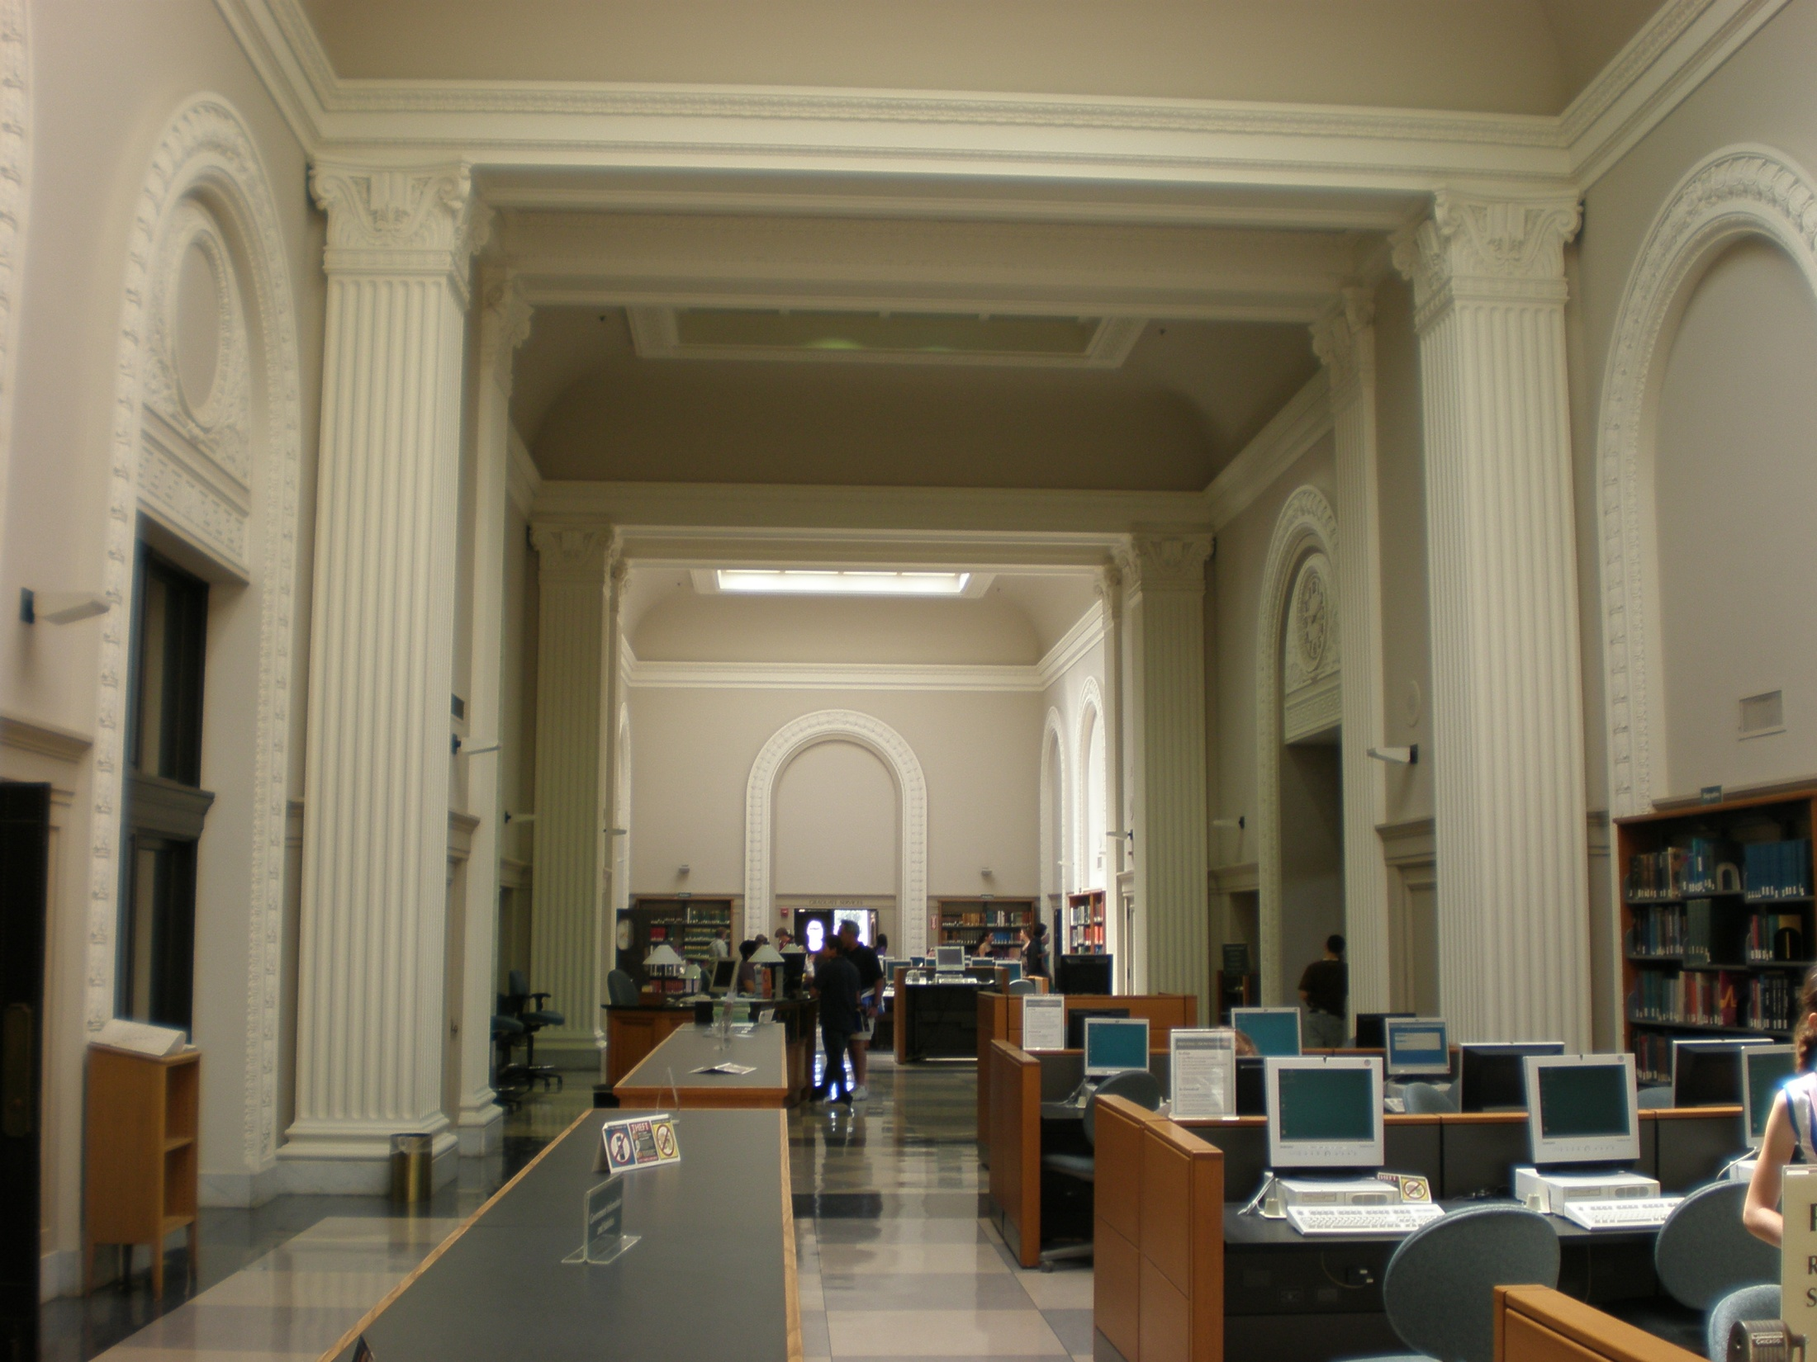

Slide 13
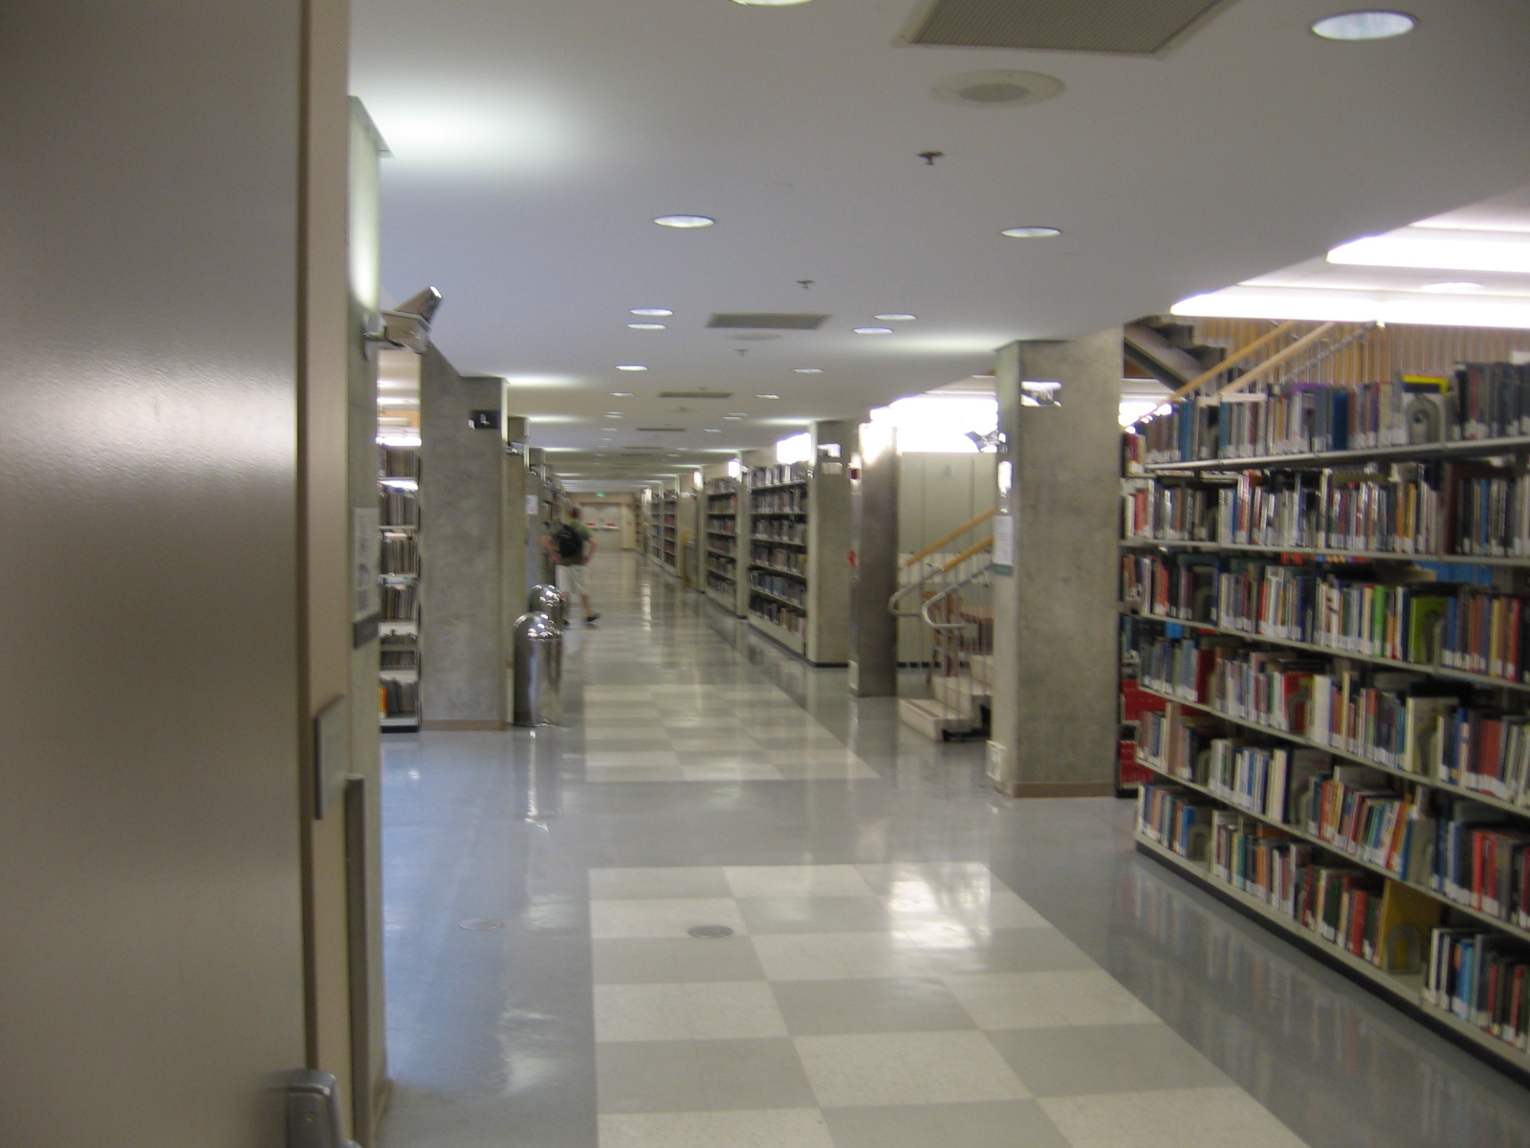

Slide 14
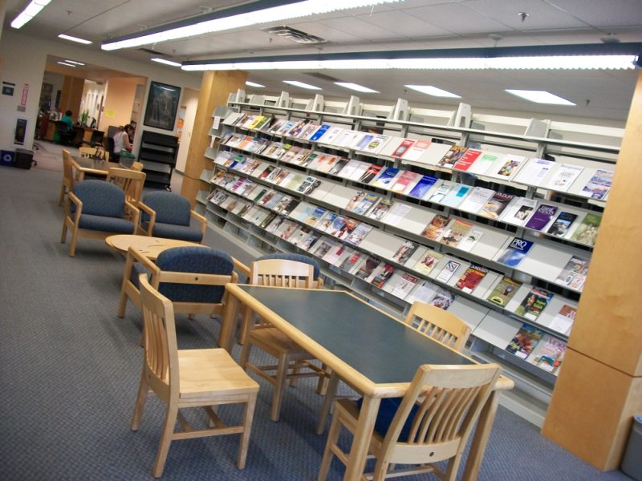

Slide 15
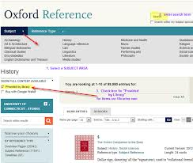
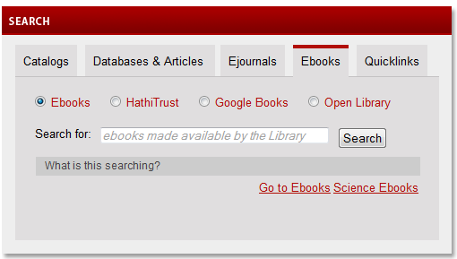

Slide 16
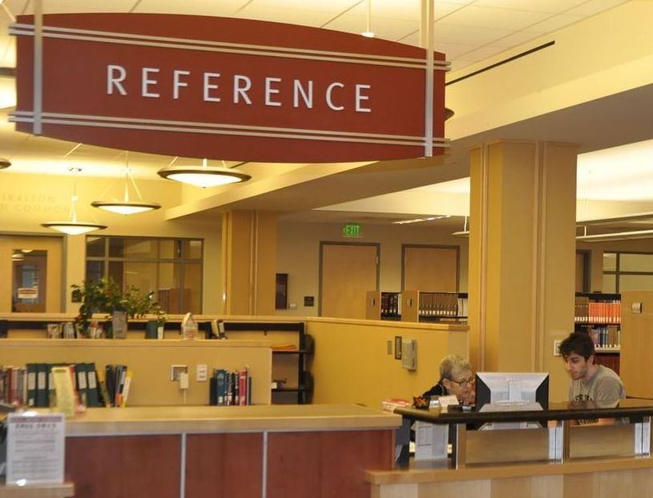

Slide 17
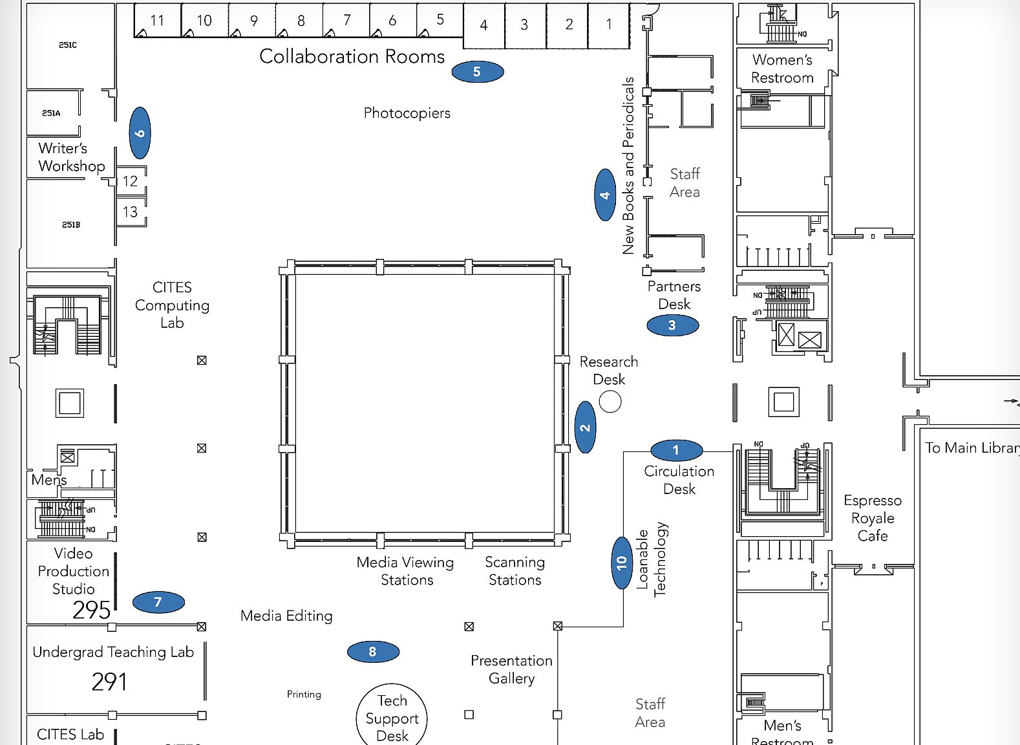

Slide 19
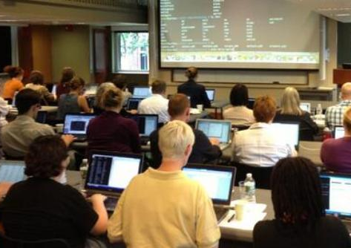

Slide 20
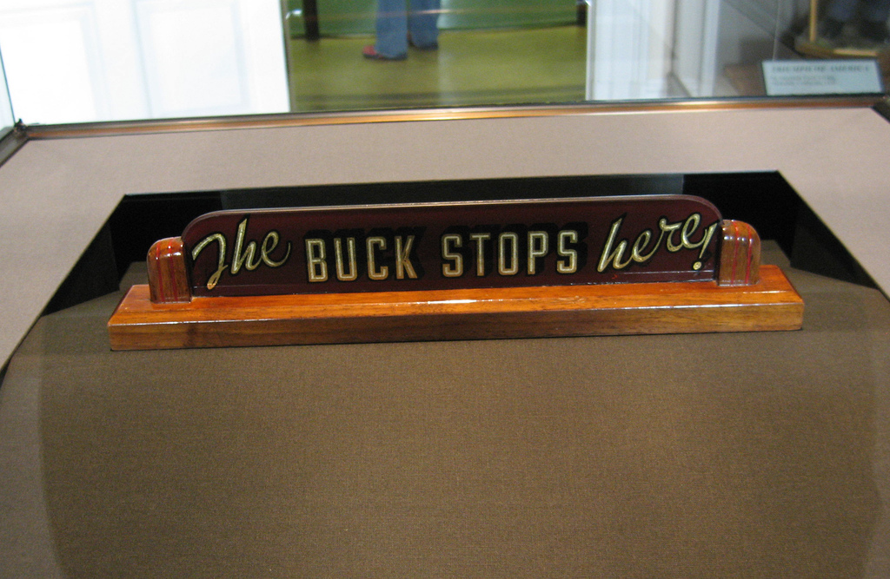

Slide 21
Part II: Methods
Assessment

Slide 22
Evaluation steps
⎫
⎫
⎫
Identify problem or need;
Describe the intervention as it should be;
Identify the hoped for outcomes;
Collect information;
Analyze information;
Present information for interpretation;
Take action on the findings.

Slide 23
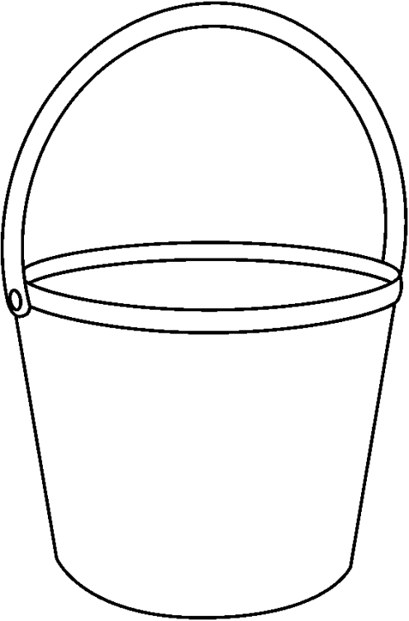
Sampling
Daytime
hours
Evening
hours
Weekend
hours

Slide 24
Sampling: Convenience Sample
x
x
✓
✓
✓

Slide 25
Sampling: Convenience Sample
Results from a convenience sample of 350 are less trustworthy than results from a representative sample of 35

Slide 26
Evaluation steps
⇨
⇨
⇨
⇨
⇨
⇨
⇨
Plan study,
Announce study and its use
Collect data
Analyze data
Interpret results
Present results
Determine next steps

Slide 27
Use of Space
Example 1: Study Spaces

Slide 28
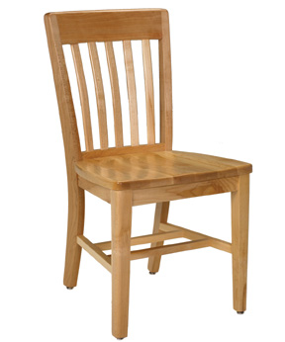
Do students need more group study space?
Sample
3.5 hrs
2.5 hrs
1 hr
Weekend
hours
Evening
hours
Daytime
hours

Slide 29
What percentage study silently alone compared to with others?
Observe
Time
Alone
Other
Empty
5:00
5:10
5:20
5:30
5:40
5:50
6:00
6:10
6:20
6:30
✓
✓
✓
✓
✓
✓
✓
✓
✓
✓

Slide 30
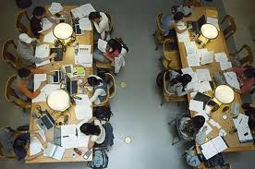

Slide 31
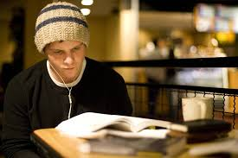

Slide 32
Use of space
Example 2: Lecture series

Slide 33
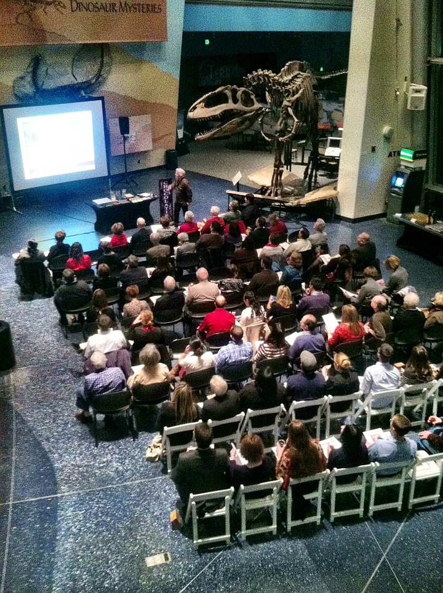
Use of space for lectures
Why people leave early?

Slide 34
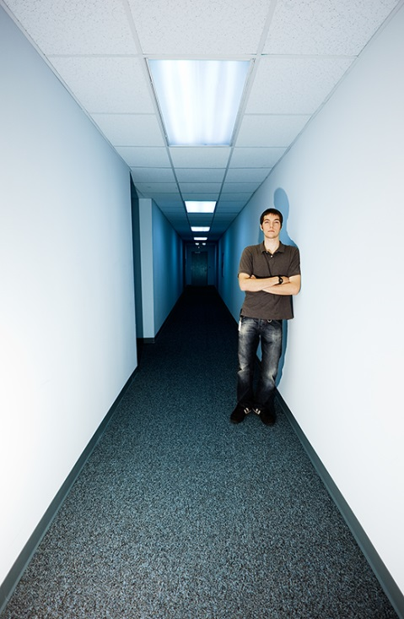
Early departers
Three questions using survey app on ipad:
Did you intend to come?
Was the speaker interesting to you?
How many talk have you attended before?

Slide 35
20 slides
5 minutes
What will you say?

Slide 36
Reference Services
Example 3: Students replicate search

Slide 37
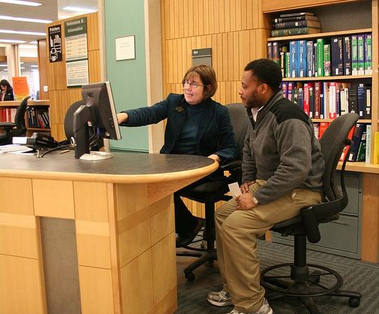
Can students replicate a search they are shown?

Slide 38
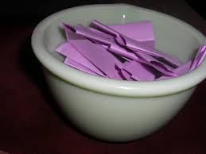
“Our librarians are trying out a new way to show students how to search. If we show you, can you do it, too?”

Slide 39
Data
Deal with it

Slide 40
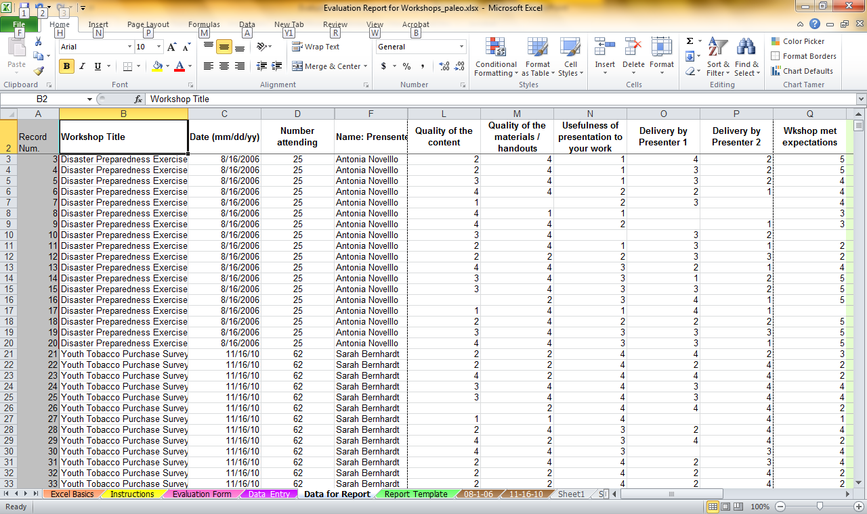

Slide 41
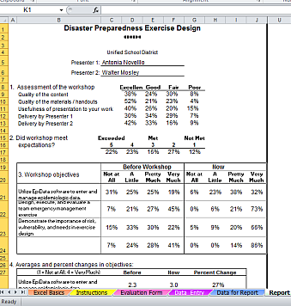
Make an auto-generated report using simple formula

Slide 42
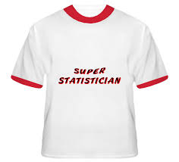
Get help from a statistician

Slide 43
Significance and substance
Something may be statistically significant without being substantially different.
p< .05
The difference is 3/10 of a percent

Slide 44
Final Words
Finally

Slide 45
Using data to move to action
Researchers think the next step is more research.
Intervention implementers think the next step is to take some incremental to change or refine the intervention.

Slide 46
Some say…
“If you’re not going to do something about it, don’t bother study it.”

Slide 47
Learning organization
Ask questions
Get answers
Discuss:
what is feasible to change and
what isn’t
Plan to change in incremental steps
Follow up.

Slide 48
Thank you!
paleo@igc.org

Slide 49
1) determine the assessment criteria, 2) use the criteria to assess, and 3) reach a conclusion.
assessments are designed to measure the performance of an individual or product and use that assessment to provide documentation of growth and development, give feedback, and create a plan of action for the future.
www.purdue.edu, www.icc.edu

Slide 50
The evaluation method focuses on determining the success of a performance, product, or set of skills. Evaluations are designed to judge and document achievement level in individuals or products. http://duke.edu/arc/documents/The%20difference%20between%20assessment%20and%20evaluation.pdf
ASK; www.purdue.edu, www.icc.edu
Assessment is an interactive process between students and faculty that informs faculty how well their students are learning what they are teaching.
essentially, it is the process of finding out whether an intervention works to mediate a problem or fill a need.

Slide 51
Collections: Possible outcomes
Own books that faculty assign
Subscribe to journals that faculty use to keep up with their field
Own materials that doctoral students need for their research
Own up-to-date and older works in proper proportions
Own and display artifacts and ephemera
Achieve proper balance of books, journals and on-line services
Achieve proper balance between owning and interlibrary loan
Balancing desired collections and shrinking budgets
Outcomes
n
Problem
or need
Collections
Impact

Slide 52
Collections:
Own books that faculty assign
Subscribe to journals that faculty use to keep up with their field
Own materials that doctoral students need for their research
Own up-to-date and older works in proper proportions
Own and display artifacts and ephemera
Achieve proper balance of books, journals and on-line services
Achieve proper balance between owning and interlibrary loan
Balancing desired collections and shrinking budgets
Outcomes
n
Problem
or need
Collections
Impact

Slide 53
Collections:
Own books that faculty assign
Subscribe to journals that faculty use
Own materials that doctoral students need for their research
Own up-to-date and older works in proper proportions
Own and display artifacts and ephemera
Achieve proper balance of books, journals and on-line services
Achieve proper balance between owning and interlibrary loan
Balancing desired collections and shrinking budgets
Outcomes
n
Problem
or need
Collections
Impact

Slide 54
Collections:
Own books that faculty assign
Subscribe to journals that faculty use to keep up with their field
Own materials that doctoral students Own up-to-date and older works in proper proportions
Own and display artifacts and ephemera
Achieve proper balance of books, journals and on-line services
Achieve proper balance between owning and interlibrary loan
Balancing desired collections and shrinking budgets
Outcomes
n
Problem
or need
Collections
Impact

Slide 55
Collections:
Own books that faculty assign
Subscribe to journals that faculty use to keep up with their field
Own materials that doctoral students need for their research
Own up-to-date and older works
Own and display artifacts and ephemera
Achieve proper balance of books, journals and on-line services
Achieve proper balance between owning and interlibrary loan
Balancing desired collections and shrinking budgets
Outcomes
n
Problem
or need
Collections
Impact

Slide 56
Collections:
Own books that faculty assign
Subscribe to journals that faculty use to keep up with their field
Own materials that doctoral students need for their research
Own up-to-date and older works in proper proportions
Own / display artifacts & ephemera
Achieve proper balance of books, journals and on-line services
Achieve proper balance between owning and interlibrary loan
Balancing desired collections and shrinking budgets
Outcomes
n
Problem
or need
Collections
Impact

Slide 57
Collections:
Own books that faculty assign
Subscribe to journals that faculty use to keep up with their field
Own materials that doctoral students need for their research
Own up-to-date and older works in proper proportions
Own and display artifacts and ephemera
Achieve proper balance of collections
Achieve proper balance between owning and interlibrary loan
Balancing desired collections and shrinking budgets
Outcomes
n
Problem
or need
Collections
Impact

Slide 58
Space: Possible outcomes
Proper light
Amenities such as copy machines
Stacks that are well-organized
Comfortable seating space Individual space
Group study space
Proper balance of noisy & quiet spaces
Events such as guest author talks
Balancing all these space needs
Space
Outcomes
n
Problem
or need
Impact

Slide 59
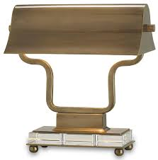
Space: Possible outcomes
Proper light

Slide 60
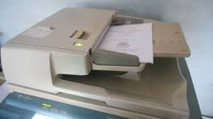
Space: Possible outcomes
Copy machines

Slide 61
Space: Possible outcomes
Well organized stacks

Slide 62
Space: Possible outcomes
Comfortable reading areas

Slide 63
Space: Possible outcomes
Comfortable individual study space

Slide 64
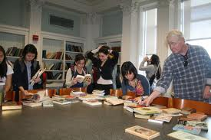
Space: Possible outcomes
Comfortable group study space

Slide 65
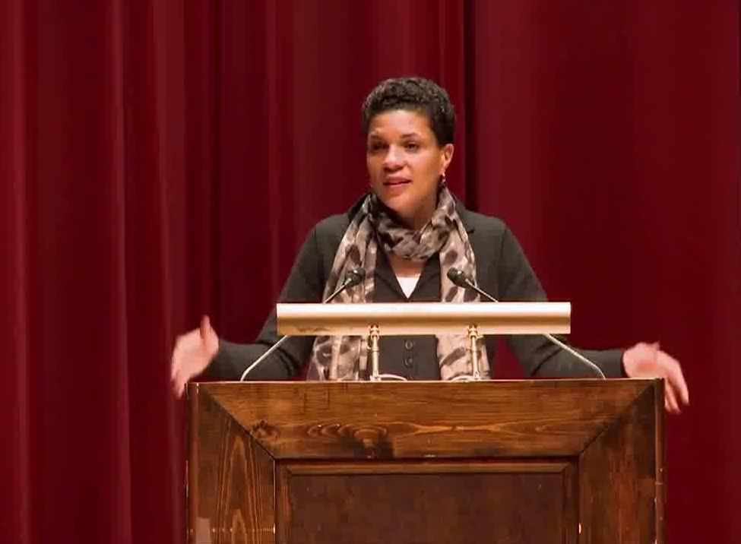
Space: Possible outcomes
Author lectures

Slide 66
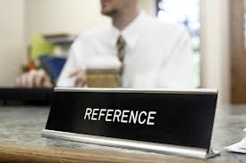
Reference: Possible outcomes
Accuracy of information

Slide 67
Not an outcome
Satisfaction with reference service

