Slide 1
Every Number Tells a Story: Using Data to Make Collection Decisions
Susan Edwards,
Education/Psychology & Social Welfare Libraries, UC Berkeley
Lynn Jones, Doe Library, UC Berkeley

Slide 2
What did we want to learn?
Do we support related disciplines equitably?
Which disciplines use which libraries?
What percent do we own or license? Compared to peers?
What is the mix of journals and books cited?
How old is the material cited?

Slide 3
Campus Demographics (April 2013)
 | Faculty (FTE) | Under- grad Majors | Masters’ and PhD students
Education | 40 | Not a major | 372
Psychology | 35 | 703 | 109
Social Welfare | 23 | 324 | 234

Slide 4
Type of Sources Cited
 | Journals | Books | Web Sources [gov docs, etc.]
Education | 46% | 47% | 7%
Psychology | 84% | 15% | <1%
Social Welfare | 59% | 33% | 8%

Slide 5
Median Age of Citations
 | Journals | Books | Combined
Education | 11 years | 13 years | 11 years
Psychology | 8 years | 14 years | 9 years
Social Welfare | 10 years | 11 years | 10 years

Slide 6
Oldest Citations
 | Books | Journals
Education | 1861 | 1935
Psychology | 1871 | 1877
Social Welfare | 1937 | 1889

Slide 7
Learn more in our session
What % we own in each discipline
Which departments use which libraries
Which students create the longest bibliographies
What we learned that we never expected

Slide 9
Every Number Tells a Story: Using Data to Make Collection Decisions
Susan Edwards,
Education/Psychology & Social Welfare Libraries, UC Berkeley
Lynn Jones, Doe Library, UC Berkeley

Slide 10
“Assessment librarians should possess an unnatural attention to details …”
Tina Chrzastowski
Assessment 101 for Librarians: A Guidebook. (2008). http://hdl.handle.net/2142/28582

Slide 11
Values Questions
Are we building the best collections we can with our resources?
Are collection development funds distributed fairly?
If we consolidate libraries, how do we minimize impact on users?

Slide 12
How to convert values questions into measurable, actionable data?

Slide 13
Quantifiable questions
Do we support related disciplines equitably?
Which disciplines use which libraries?
What percent do we own or license? Compared to peers?
What is the mix of journals and books cited?
How old is the material cited?

Slide 14
Project Methodology

Slide 15
Campus Demographics
 | Faculty (FTE) | Under- grad Majors | Masters’ and PhD students
Education | 40 | Not a major | 372
Psychology | 35 | 703 | 109
Social Welfare | 23 | 324 | 234

Slide 16
Sample Size Derivation
 | Disser-tations | Total Citations | Citations Entered | Sample size
 |  |  |  | for 95% (+/-3) | for 95% (+/-4)
Education | 57 | 6576 | 1340 | 918 | 550
Psychology | 28 | 3899 | 644 | 838 | 520
Social Welfare | 22 | 3719 | 741 | 829 | 517
Total | 107 | 14,194 | 2725 | 2585 | 1587

Slide 17
Findings

Slide 18
Libraries Usage by Education Dept (April 2013)
Faculty |  | Grad Students
Library | Books Borrowed | Library | Books Borrowed
Main / Moffitt | 331 | Education/Psychology | 809
Education/Psychology | 266 | Main /Moffitt | 457
NRLF | 82 | Anthropology | 44
Anthropology | 12 | Business | 34
Social Welfare | 8 | NRLF | 34
Bioscience | 4 | Social Welfare | 31
Business | 3 | Ethnic Studies | 19
Earth Science/Maps | 3 | Bioscience | 8
Mathematics/Statistics | 3 | Environmental Design | 8
Ethnic Studies | 2 | Mathematics/Stat | 6
Total | 714 | Music | 3
 |  | Public Health | 2
 |  | Earth Science/Maps | 1
 |  | Physics/Astronomy | 1
 |  | Total | 1457

Slide 19
Checkouts by Faculty, Most-Used Libraries (April 2013)
Social Welfare Faculty |  | Education Faculty |  | Psychology Faculty
Library | Borrowed | Library | Borrowed | Library | Borrowed
Social Welfare | 101 | Main/Moffitt | 331 | Education/ Psychology | 68
Main/Moffitt | 51 | Education/ Psychology | 266 | Main/Moffitt | 16
Education/ Psychology | 39 | NRLF | 82 | Music | 11
Total | 206 | Total | 714 | Total | 178

Slide 20
Checkouts by Graduate Students, most-used libraries (April 2013)
Social Welfare Grad Students |  | Education Grad Students |  | Psychology Grad Students
Library | Borrowed | Library | Borrowed | Library | Borrowed
Social Welfare | 236 | Education/ Psychology | 809 | Education/ Psychology | 119
Main/Moffitt | 216 | Main/Moffitt | 457 | Main/Moffitt | 34
Business | 82 | Anthropology | 44 | Biosciences | 10
Education/ Psychology | 45 | Social Welfare | 31
total | 631 | total | 1457 | total | 178

Slide 21
Highest Circulation in the EdPsych Library, FY13
RC 0435 - RC 0580.9999 Psychiatry
BF 0309 - BF 0499.9999 Consciousness: Including learning, attention, comprehension
LB 0001 - LB 1049.8999 Theory & Practice of Education
LC 1390 - LC 4000.9999 Education of special classes of persons
LC 0189 - LC 0214.5399 Educational sociology
BF 0501 - BF 0593.9999 Motivation; Affection. Feeling. Emotion
LB 2801 - LB 2863.9999 School Administration/Organization
Notes:
Could this be inserted as slide 15, following check outs by grad students, most used libraries?

Slide 22
Median Number of Citations per Dissertation
Education | 118
Psychology | 115
Social Welfare | 168

Slide 23
Percent Citations Owned or Licensed
 | Journals | Books
Education | 98% | 88%
Psychology | 99% | 87%
Social Welfare | 97% | 73%

Slide 24
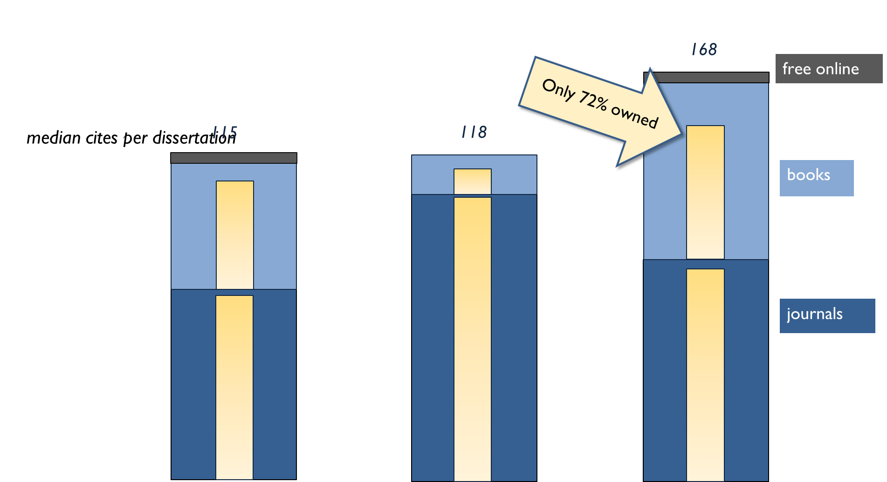
Education
Psychology
Social Welfare

Slide 25
Type of Sources Cited
 | Journals | Books | Web Sources [gov docs, etc.]
Education | 46% | 47% | 7%
Psychology | 84% | 15% | <1%
Social Welfare | 59% | 33% | 8%

Slide 26
Median Age of Citations
 | Journals | Books | Combined
Education | 11 years | 13 years | 11 years
Psychology | 8 years | 14 years | 9 years
Social Welfare | 10 years | 11 years | 10 years

Slide 27
Oldest Citations
 | Books | Journals
Education | 1861 | 1935
Psychology | 1871 | 1877
Social Welfare | 1937 | 1889

Slide 28
Unexpected findings

Slide 29
Tools you can take home
sample size calculator http://www.surveysystem.com/sscalc.htm
random number generator http://www.random.org/
bibliography
http://tinyurl.com/EdwardsJonesbib
want our spreadsheet? email us

Slide 30
Lyn Paleo, DrPH Instructor, UCB School of Public Health Evaluation Manager, First 5 Contra Costa County Jon Stiles Executive Director, California Census Research Data Center Director of Archive Services, UC Data Archive & Technical Assistance
were instrumental in providing advice and assistance in this project. Thank you both.

Slide 31
sedwards@library.berkeley.edu ljones@library.berkeley.edu
Contact us for more information

