Slide 1
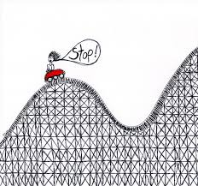
TRAINING DAY 6
A Tour of RDA and the (BSR) for Textual Monographs in MARC tag order
Notes:
This day builds on previous training by taking a look at RDA the way most of us will most often: from the perspective of building (or evaluating) a MARC bibliographic record.
As the picture indicates: we’ll attempt to move through quickly—at least more quickly than Days 3-5, because…

Slide 2
Acronyms (We all should know)
BSR=
LC/PCC PS=
WEMI=
PFC=
AAP=
UCB PS=
BIBCO Standard Record
Library of Congress/Program for Coop Cat. Policy Statements (RDA equiv. of LCRI)
Work, Expression, Manifestation, Item (FRBR Grp. 1)
Person, Family, Corporate body (FRBR Grp.2)
Authorized Access Point for any of the above two (formerly “heading”)
UC Berkeley Policy Statements
Notes:
And since we have all been here before; I’m looking for some audience participation
Beginning with this: here are some acronyms we will be throwing around a lot today. Let’s be sure we all know what is being talked about.

Slide 3
Acronyms (Extra Credit)
COEP=
TWYS=
FISO=
Concept, Object, Event, Place (FRBR Grp. 3 entities)
Take What You See
Find, Identify, Select, Obtain (FRBR user tasks)
Notes:
And since we have all been here before; I’m looking for some audience participation
Beginning with this: here are some acronyms we will be throwing around a lot today. Let’s be sure we all know what is being talked about.

Slide 4
Why MARC tag order?
RDA instructions are arranged to identify MIWE/PFC/COEP and record relationships between them
MARC IS NOT!!
RDA Instructions are for how/what to record—not where to record it.
Instructions on the information recorded in a given MARC tag are sometimes widely scattered throughout RDA.
MARC will be replaced, but not in the foreseeable future.
Notes:
MARC tags are arranged in the order they might appear on a catalog card,
MARC going away but still with us, and will be for some time

Slide 5
Objectives for Day 6
At the end of this day, you will be able to:
Relate MARC record tags to relevant RDA instructions.
Scan existing RDA copy for errors and for omission of PCC Core elements
Create an RDA bib record in MARC format from scratch on OCLC
Walk away knowing you have COMPLETED basic RDA training and will never have to do it again!!!
Notes:
Emphasis here is on BASIC RDA training.
More specialized training in other formats will occur later.
Note that we will, once again, be focusing on textual monographs.

Slide 6
Cataloging the RDA way
Examine a resource exemplified as an:
ITEM
to identify attributes of a:
MANIFESTATION
including the:
WORK
and/or the
EXPRESSION manifested
as well as its (the resource’s)relationships to:
PFCs
COEPs
other WEMI
Notes:
It’s good to keep in mind that when we are cataloging this is essentially what we are doing in FRBR speak. Note that it is all about the Group 1,2, and 3 entities and their relationships.

Slide 7
[MARC TAG]
[Element name]
[Entity/RDA section]
[RDA instruction]
Core?
[Differences from AACR2; things to keep in mind]
Notes:
Form of most of the upcoming slides;
Shorthand for sections Attributes of IMWE
Also examples
And there will be exercises

Slide 8
Leader, 008 Fixed fields
BLVL (LDR byte07)
Mode of issuance
Manifestation
RDA 2.13
Core
LC/PCC PS instructs to use BLVL for this element; “m” for monographs
LANG (008 byte 35-37)
Language of expression
Expression
RDA 6.11
Core
Record primary language of the work here; for resources in more than one language also see 546 and 041
Notes:
RDA Elements accounted for entirely in the 008

Slide 9
Leader, Fixed fields (008)
Notes:
Fixed fields largely alternate coding for elements in the rest of the MARC record
Blue fields represent PCC BSR Core fixed fields
Values shown are for textual monographs
Desc is i or c; no longer a

Slide 10
020
Identifier for manifestation
Manifestation
RDA 2.15
Core
ISBN; instruction pertains also to other identifiers, e.g. ISSN, SUDOC, URN (which have other 0XX tags)

Slide 11
041
Language of expression
Expression attribute
RDA 6.11
Core
For resources that are translations and/or contain more than the primary language of the work. BSR: record here and in 546
Notes:
BSR MAP indicates to “record if needed to differentiate”, i.e. if resource is in more than one language;
In that case use 546 and 041.

Slide 12
[040]
Cataloging source
No RDA instruction
Core
Always add $b “eng” and $e “rda”
e.g.: 040__ CUY $b eng $e rda $c CUY

Slide 13
100, 110, 111
Creator of work
PFC/Work relation
RDA 19.2
Core
For principal or first-named creator
Families can be creators
Use AAP for PFC
Notes:
The 1xx is used to record the “creator” of the work manifested in the resource.
RDA. 19.2 defines the “creator” of a work as the (PFC) principally responsible for the creation of a work. If there is no principle creator the first-named on the manifestation goes in the 1xx.
Collaborations will always get a 1xx as it doesn’t matter how many PFCs involved in the collaboration.
Note that families can now be responsible for the creation of a work.
The form of name in the 100 is the AAP for the PFC; note that if this has not been established refer to instructions at 9.19, 10.10 and 11.13 to “float” an AAP.

Slide 14
100, 110, 111/$e and $j
Relationship designator
PFC/Work relation
RDA 18.5
Core for creators
A 1xx should always have a relationship designator
Use $j with 111
For 100, 110, 111 use only terms found in app. I.2
Omit preceding comma after an open date
Notes:
Relationship designator is not noted as core in RDA or LC PCC PS; but a PCC guidelines document states they are core for creators of works; 100 should always have one.
it goes in $e preceded by a comma except when following an open date.
It is UCB policy to use only terms from the list for PFC’s associated at the work level in Appendix I.2 in the 1xx.

Slide 15
100, 110, 111
100 1 Dutton, Mary Ann, ǂd 1949- ǂe author.
245 10 Use and outcomes of protection orders by battered immigrant women : ǂb revised final technical report / ǂc Mary Ann Dutton, Nawal Ammar, Leslye Orloff, Darci Terrell ; prepared for National Institute of Justice, Office of Justice, Programs.
100 1 Blandford, Audrey A., ǂe compiler.
245 1 0 Profile of Manitoba's seniors 2010 / ǂc compiled by Audrey Blandford.
…
520 8 "The Profile of Manitoba's Seniors is intended to be a reference book highlighting a wide variety of statistical information about Manitoba's older population.
100 1 Beard, T. K., ǂe defendant, ǂe appellant.
245 1 0 Oakdale Irrigation District, a corporation, plaintiff and respondent, vs. T.K. Beard and the Aetna Accident & Liability Company, a corporation, defendants and appellants : ǂb appellants' points and authorities / ǂc for the defendants and appellants, Messrs. L.L. Dennett and Dennett & Zion, Modesto, and Redman & Alexander, San Francisco ; for plaintiff and respondent, P.H. Griffin, Modesto, Cal.
Notes:
No comma following the open date
As with AACR2 a compiler of data such as statistics or a bibliography is considered a creator of a new work
Other persons associated with a work can, under circumstances also appear in a 1xx

Slide 16
130; 240
Preferred title of the work manifested
Primary Work relation;
RDA 17; 6.2; 6.27
Core
Title of the work represented in the resource being cataloged.
Use 240/130 if preferred title for a work is different from the title proper of the manifestation being cataloged.
Notes:
When using the AAP for the work/expression to identify the work manifested and/or expressed in the manifestation
Used when the preferred title for the work or expression varies from the title proper of the manifestation.
LC PCC PS 6.27.3 gives LC practice for identifying expressions; PCC practice is awaiting a task group report; for now ?
LC PCC PS refers to instructions on identifying works and expressions in Chapter 6; specifically this means instructions 6.27.1-3 on constructing AAP’s for works/expressions

Slide 17
130; 240
…
100 1 Shakespeare, William, ǂd 1564-1616, ǂe author.
240 1 0 Hamlet
245 1 4 The tragedy of Hamlet / ǂc edited by Edward Dowden.
…
Notes:
Title on the manifestation is tragedy of hamlet;
This differs from the AAP for the work and (in this case, working backward) the preferred title for the work manifested
Thus we use a 240 to identify the work.

Slide 18
130; 240
Preferred title of the expression
Primary expression relationship
RDA 17; 6.27.3
Core
Use 130; 240 to identify the expression manifested for translations from the original language of the work by adding the language of the translation to the preferred title for the work.
Notes:
When using the AAP for the work/expression to identify the work manifested and/or expressed in the manifestation
Used when the preferred title for the work or expression varies from the title proper of the manifestation.
LC PCC PS 6.27.3 gives LC practice for identifying expressions; PCC practice is awaiting a task group report; for now ?
LC PCC PS refers to instructions on identifying works and expressions in Chapter 6; specifically this means instructions 6.27.1-3 on constructing AAP’s for works/expressions

Slide 19
130; 240
100 1 Hemingway, Ernest, ǂd 1899-1961, ǂe author.
240 1 0 For whom the bell tolls. ǂl Romanian
245 1 0 Pentru cine bat clopotele : ǂb roman / ǂc Ernest Hemingway ; prefață de Dan Grigorescu ; traducere și tabel cronologic de Dumitru Mazilu.
264 1 București : ǂb Editura Minerva, ǂc 1971.
300 340 pages ; ǂc 17 cm
…
Notes:
An example where the 100/240 combination is used to identify a language expression of the work.
The title proper on the manifestation is for a Romanian translation of Hemingway’s For Whom the Bell Tolls; the AAP for the expression is the AAP for Hemingway combined with the preferred title for the work, (which would be the original language title) and the language of the expression.

Slide 20
240; 130
Conventional collective title for compilations of works by a single PFC
Work attribute
RDA 6.2.2.10
Core if applicable
Use a conventional collective title
Complete works in more than one form: Works
Complete works in a single form: Essays, Novels, Correspondence… (complete list at RDA 6.2.2.10.2)
Some but not all works:
Works. $k Selections
[Essays…etc.]. $k Selections
Notes:
For some, but not all works in several or one form add $k Selections to the title. This is the alternative in RDA 6.2.2.10.3 which the PS instructs to use.
Note you can no longer use “Selections” on its own in a $t.

Slide 21
130; 240
…
100 1 Brown, Charles Brockden, ǂd 1771-1810, ǂ e author.
240 1 0 Works
245 1 0 Collected writings of Charles Brockden Brown / ǂc general editor, Mark L. Kamrath ; textual editor, Philip Barnard.
…
Notes:
Purportedly the complete works of Charles Brockden Brown. Add Conventional title works.

Slide 22
240, 130
…
100 1 Mailer, Norman, ǂe author.
240 1 0 Essays. ǂk Selections
245 1 0 Mind of an outlaw : ǂb selected essays / ǂc Norman Mailer ; edited and with a preface by Phillip Sipiora ; introduction by Jonathan Lethem.
…
Notes:
For compilations of two or more (but not all) the works of a single PFC add a subfield k with the term “Selections”;

Slide 23
245, ǂa
Title proper of manifestation
Manifestation attribute
RDA 2.3.2
Core
Bracket title proper information only if taken from outside the resource
Transcribed element (see RDA 1.7):
TWYS transcription ok for copy
App. A capitalization for original (UCB policy)
separate elements with ISBD punctuation as with AACR2.
Other punctuation TWYS
UC PS allows using cataloger judgment to apply option to abridge an excessively long title; use ellipses (…)
Notes:
RDA 1.7/appendix A instructions on transcription; Capitalization-LCPCC PS for appendix A allows "take what you see" or use App. A; UCB will use App. A, but accept copy that uses the “TWYS" approach.
UC; the option to abridge very long titles is not applied according to LC PCC PS, but Berkeley policy is to allow it

Slide 24
245 ǂb
Parallel titles/other title information
Manifestation attribute
RDA 2.3.3 & .4
Core (PCC)
Record all parallel titles proper found in any source on the resource
Take other title information from the same source as the title proper
Notes:
Parallel titles may now be taken from anywhere within the resource.

Slide 25
245, ǂc
Statement of responsibility on manifestation
Manifestation attribute
RDA 2.4
Core (first or primary statement only)
PCC recommends recording most or all
Apply the option to abridge (2.4.1.4) for original cataloging
No ‘rule of three’; record all names in a statement, or …
Apply the option to truncate statements (2.4.1.5) using cataloger judgment
Notes:
Only the first s.o.r is core but PCC recommends recording all that would “aid in resource discovery, identification and selection
Abridging means not recording non-essential information (e.g. Dr., Mrs., etc.); UCB PS allows the option but accept copy that transcribes it
Truncating means not recording all names in a s.o.r naming many PFC’s; use [and __ others]

Slide 26
245 1 0 Field monitoring protocol : ǂb heat pump water heaters / ǂc B. Sparn, L. Earle, D. Christensen, J. Maguire, and E. Wilson, National Renewable Energy Laboratory, C.E. Hancock, Mountain Energy Partnership.
245 1 0 Field monitoring protocol : ǂb heat pump water heaters / ǂc B. Sparn [and five others].
Notes:
Both 245’s are acceptable; second probably preferable

Slide 27
246
Variant title (on manifestation)
Manifestation attribute
RDA 2.3.6
PCC core only for rare (but PCC recommended)
Titles appearing on but not chosen as the title proper for the manifestation.
Lengthy LC PCC PS on best practices.
Notes:
A variation from the title in 245 found on the resource or in reference sources, such as a cover or spine title; also use for MVM if the title changes between volumes
Also for additional titles borne by a manifestation unless they are for independent works (in the case of aggregate works with multiple titles in the 245) in those cases may use 7xx which we will discuss when we come to it.

Slide 28
250
Edition statement
Manifestation attribute
RDA 2.5
Core; designation of edition or named revision
Transcribed element so record as found
Can supply if known to have changes (e.g. [New draft] or [Revised draft].
Notes:
Designation of edition and named revision of an edition is core; other elements optional (statement of responsibility etc.
TWYS; abbreviate only if abbreviation is found on source; also record numbers as found source, i.e. as numerals or words.
If it is known that the manifestation in hand is different from a previous manifestation an edition statement (in brackets) may be supplied.

Slide 29
250
…
100 1 Hambley, Allan R., ǂe author.
245 1 0 Electrical engineering : ǂb principles and applications / ǂc Allan R. Hambley.
250 Sixth edition.
…
Notes:
The edition designation found on the source is spelled out so recorded as such in the 250.

Slide 30
Cataloging Examples
Please fill in applicable MARC tags on workforms for Examples B, C and E
Notes:
Please record fields through 250 for Cat. Examples B, C and E

Slide 31
Example B
Type a ELvl I Srce Audn Ctrl Lang eng
BLvl m Form Conf 0 Biog MRec Ctry enk
Cont b GPub LitF 0 Indx 1
Desc i Ills Fest 0 DtSt s Dates 1999 ,
040 CUY ǂb eng ǂe rda ǂc CUY
020 9780631206996 (alk. paper)
245 0 4 The Third Reich : ǂb the essential readings / ǂc edited by Christian Leitz ; advisory editor: Harold James.
Notes:
Not much to do because this is a compilation—hence we have no creator to go in the 1xx.
Housekeeping: Desc is “i” ; remember 040 with $e “rda”

Slide 32
Example C
Type a ELvl I Srce d Audn Ctrl Lang eng
BLvl m Form Conf 0 Biog MRec Ctry nyu
Cont b GPub LitF 0 Indx 0
Desc i Ills a Fest 0 DtSt s Dates 2007 ,
040 CUY ǂb eng ǂe rda ǂc CUY
020 9780975392102
041 1 eng ǂa fre ǂh eng
245 0 0 Dan Walsh : ǂb paintings.
246 3 0 Paintings
Notes:
Resource is a compilation of reproductions of Dan Walsh paintings, the essays written by others. (We know who did what).
There are translations into French of the essays and interview, so need 041

Slide 33
Example E
Type a ELvl I Srce Audn Ctrl Lang eng
BLvl m Form Conf 0 Biog MRec Ctry enk
Cont bc GPub LitF 0 Indx 1
Desc i Ills Fest 0 DtSt s Dates 1981 ,
040 CUY ǂb eng ǂe rda ǂc CUY
020 9780824095536
110 2 British Library. ǂb Reference Division, ǂe author.
245 1 0 Catalogue of books and periodicals on Estonia in the British Library Reference Division / ǂc compiled by Salme Pruuden ; edited by Dalibor B. Chrástek, Christine G. Thomas.
246 3 Catalog of books and periodicals on Estonia in the British Library Reference Division
Notes:
Why is the creator the British Library Reference Division?
(See RDA 19.2.1.1.1; corporate bodies as creators)

Slide 34
264 _0
Production statement
Manifestation attribute
RDA 2.7
Date of production is core
For unpublished resources only
Notes:
264 replaces 260
Date of production is a core element IF something is unpublished; other elements are optional

Slide 35
264 _1 $a
Place of publication
Manifestation attribute
RDA 2.8.2
Core
Preferred source same as source for publisher’s name.
If not found in preferred source may be taken from any source.
Only first recorded is required
Transcribed element-TWYS.
Notes:
Only one—the first recorded, meaning the first or most prominent place.
Avoid using Place of publication not identified; you may make an educated guess at place
In that case or if place is taken from outside the resource use brackets and question mark as appropriate.

Slide 36
264 _1 $b
Publisher’s name
Manifestation attribute
RDA 2.8.4
Core
Preferred source same as for title proper.
If not found in preferred source may be taken from any source.
Only the first recorded is required.
Transcribed element-TWYS.
Notes:
Transcribe as found; LC/PCC instructs not to omit levels in corporate hierarchy, but UC PS allows the option.

Slide 37
264 _1 $c
Date of publication
Manifestation attribute
RDA 2.8.6
Core
Preferred source same as title proper.
Date of publication may be inferred from copyright date
Record numerals as found; numbers expressed as words as numbers.
Notes:
add Gregorian/Julian equivalents.
When inferring date, or date not found on resource enclose in brackets.

Slide 38
264 _1
264 _1 Chicago : ǂb Herbert S. Stone & Company, ǂc MDCCCXCIX.

Slide 39
264 _1
[title page]
Rebel Mexico
Student Unrest and Authoritarian Political Culture During the Long Sixties
Jaime M. Pensado
Stanford University Press
Stanford, California
[colophon]
Stanford University Press Stanford, California © 2013 by the Board of Trustees of the Leland Stanford Junior University. All rights reserved. No part of this book may be reproduced or transmitted in any form or by any means, electronic or mechanical, including photocopying and recording, or in any information storage or retrieval system without the prior written permission of Stanford University Press. Printed in the United States of America on acid-free, archival-quality paper
264 _1 Stanford, California : ǂb Stanford University Press, ǂc [2013]

Slide 40
264 _2
Distribution statement
Manifestation attribute
RDA 2.9
Core if place of publication, publisher or date not available
Only elements corresponding to the ones missing from publication statement are core.
Notes:
Information on distribution and/or manufacture is required only if present on the resource, AND if publication information is lacking.
TWYS applies as in statement of publication

Slide 41
264 _3
Manufacture statement
Manifestation attribute
RDA 2.10
Core if no place of publication and no place of distribution, no publisher or distributor, date of publication and distribution not available
Only elements not given in statements of publication or distribution are core.
Date only core if no other date available
Notes:
Information on distribution and/or manufacture is required only if present on the resource, AND if publication/distribution information is lacking.
Date of manufacture recorded only if no other date; if there is a copyright date use that.
TWYS applies as in statement of publication

Slide 42
264 _4
Copyright date
Manifestation attribute
RDA 2.11
Core if other than date of publication or distribution
Date preceded by symbol or designation of copyright or of phonogram copyright.
Preferred practice is not to record if same as inferred date of publication.
Notes:
Record only if no date of publication or distribution is identified; note: it is acceptable to infer a date of publication from a copyright date if that is all that is found on the resource. Record it in the 264_1 in ǂc in brackets; in this case it is a common practice to omit repeating the date in a 264_4.

Slide 43
264 _1 Lanham : $b Jason Aronson, $c [2013]
[colophon]
Published by Jason Aronson A wholly owned subsidiary of The Rowman & Littlefield Publishing Group, Inc. 4501 Forbes Boulevard, Suite 200, Lanham, Maryland 20706 www.rowman.com 10 Thornbury Road, Plymouth PL6 7PP, United Kingdom
Copyright © 2013. Jason Aronson, Inc.. All rights reserved.
[title page]
Jason Aronson
Lanham • Boulder • New York • Toronto • Plymouth, UK

Slide 44
264 _1 London : $b Routledge, $c 1994.
[colophon]
Italian edition, Aristofane autore di teatro, first published 1962 by G.C. Sansoni, Firenze
Revised Italian editions published 1984, 1992
Revised and expanded English edition first published 1994 by Routledge 11 New Fetter Lane, London EC4P 4EE
Simultaneously published in the USA and Canada by Routledge 29 West 35th Street, New York, NY 10001
Italian edition © 1962, 1984, 1992 Carlo Ferdinando Russo
English edition © 1994 Carlo Ferdinando Russo
[title page]
ARISTOPHANES AN AUTHOR FOR THE STAGE
Carlo Ferdinando Russo
London and New York
Notes:
Preferred source for place is same source as publisher; no publisher on t.p. so go with place associated with publisher name in colophon
We know from a source outside the resource that this US/Canadian edition was published in 1997; the copyright date differs significantly from the date of publication so include 264_4

Slide 45
300 $a
Extent of text
Manifestation attribute
RDA 3.4.5
Core if a resource is complete
Names of units (e.g. pages, volumes) are spelled out
Use “1 volume (unpaged)” and “unnumbered sequence of [‘pages’ or ‘leaves’]” (UCB PS 3.4.5.3 and 3.4.5.8)
Notes:
The 300 field brings together RDA elements identifying the carrier of the resource and elements identifying the content of the resource.
Extent of text is a characteristic of the carrier, and the carrier is an attribute of the manifestation
Content is a broader aspect applying to the work or expression; carrier is the physical form of the manifestation; book vs. microfilm e.g. these are characteristics of the manifestation.
300 $a is used to record the extent of the carrier; since we are focusing on print monographs we’ll look at instructions relating to extent in terms of text; there many instructions in RDA 3 for carriers other than printed texts.
Extent of text is a core element also if the resource is incomplete but the total extent is known.
Not much change here from AACR2; units are spelled out; the UC PS instructs to follow LC practice in cases of unnumbered pages or mix of numbered and unnumbered pages

Slide 46
300 $b
Illustrative content
Expression attribute
RDA 7.15
Not Core
UCB PS record only if predominant (significant).
Use “illustrations”
Accept copy with other terms in $b
Notes:
Illustrative content is an attribute of the expression
Core element only for LC, and then only for resources intended for children; there is a UCB PS that instructs to record only where illustrations are predominate, or form a substantial part of the resource
Spell out illustrations

Slide 47
300 $c
Dimensions of volume (carrier)
Manifestation attribute
RDA 3.5.1.4.14
Not core
Core for UCB original cat
Change in copy cat if > 31cm or < 15cm
Use symbol “cm” for centimeters—no period.
Notes:
$c dimensions is a core element for UCB original cat.
Also core for copy cat. If exceeds 32 cm or is less than 16 cm;
300 DOES end with a full stop if there is a series statement (490).

Slide 48
300 $e
Accompanying material(carrier)
Manifestation attribute
RDA 3.1.4
Not core
One of several options for recording details; for details see LC PCC PS.
UCB preferred policy is in development.
Notes:
$e is one option for recording details on the carrier and content of accompanying materials according to LC PCC PS 3.1.4; the other options are to repeat 300 tag giving details on extent and content or, in cases of less significant accompanying materials to give the information in a note.
UCB recommendations in development

Slide 49
336
Content type
Expression attribute
RDA 6.9
Core
May be included in AACR2 records.
Use terms from table at RDA 6.9.1.3
“text” for textual monographs
UCB PS: Repeat field for multiple content types and use $3.
Notes:
Fields 336, 337 and 338 are the most visible new “RDA field tags”, although they may be used in AACR2 records as well now.
Field 336 is for recording the content type of the expression
UCB PS instructs to record multiple content types in a resource in separate 336 fields; indicate which part of the resource each 336 applies to in $3
Terms in the $3 should be consistent with terms used in 300 or in 300 $e or notes referring to accompanying material.

Slide 50
337
Media type
Manifestation attribute
RDA 3.2
Core for LC/PCC
Use term from table at RDA 3.2.1.3
“unmediated” for textual monographs
Repeat multiple media types and use $3.
Notes:
Media type is an attribute of the carrier; thus a manifestation level attribute;
UCB PS instructs to repeat for multiple media types in the same resource as with content type.
Again, remember this tag is also valid in AACR2 records now.

Slide 51
338
Carrier type
Manifestation attribute
RDA 3.3
Core
Take term from list at RDA 3.3.1.3
“volume” for textual monographs
Repeat field for multiple carrier types and use $3.
Notes:
Carrier type is a manifestation level attribute;
UCB PS instructs to repeat for multiple carrier types in the same resource as with content and media type.
There is now an OCLC macro available to facilitate adding this and the 337 and 338 fields to records; the macro includes a $b for a code representing the term in $a. This code is not a core element-we will use the macro to input it, but also accept records with 336-338 fields lacking the codes.

Slide 52
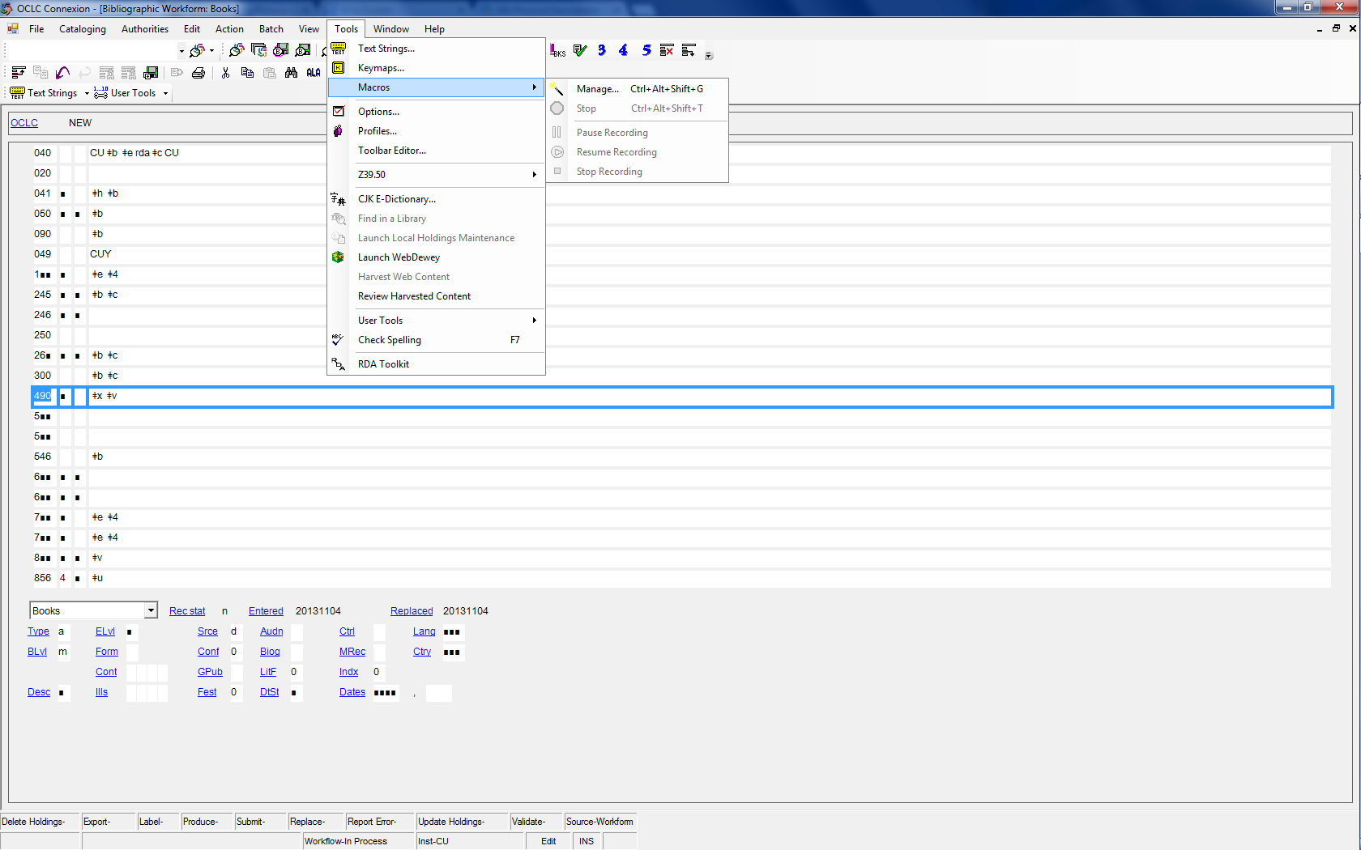
Notes:
Go to tools/macros/manage

Slide 53
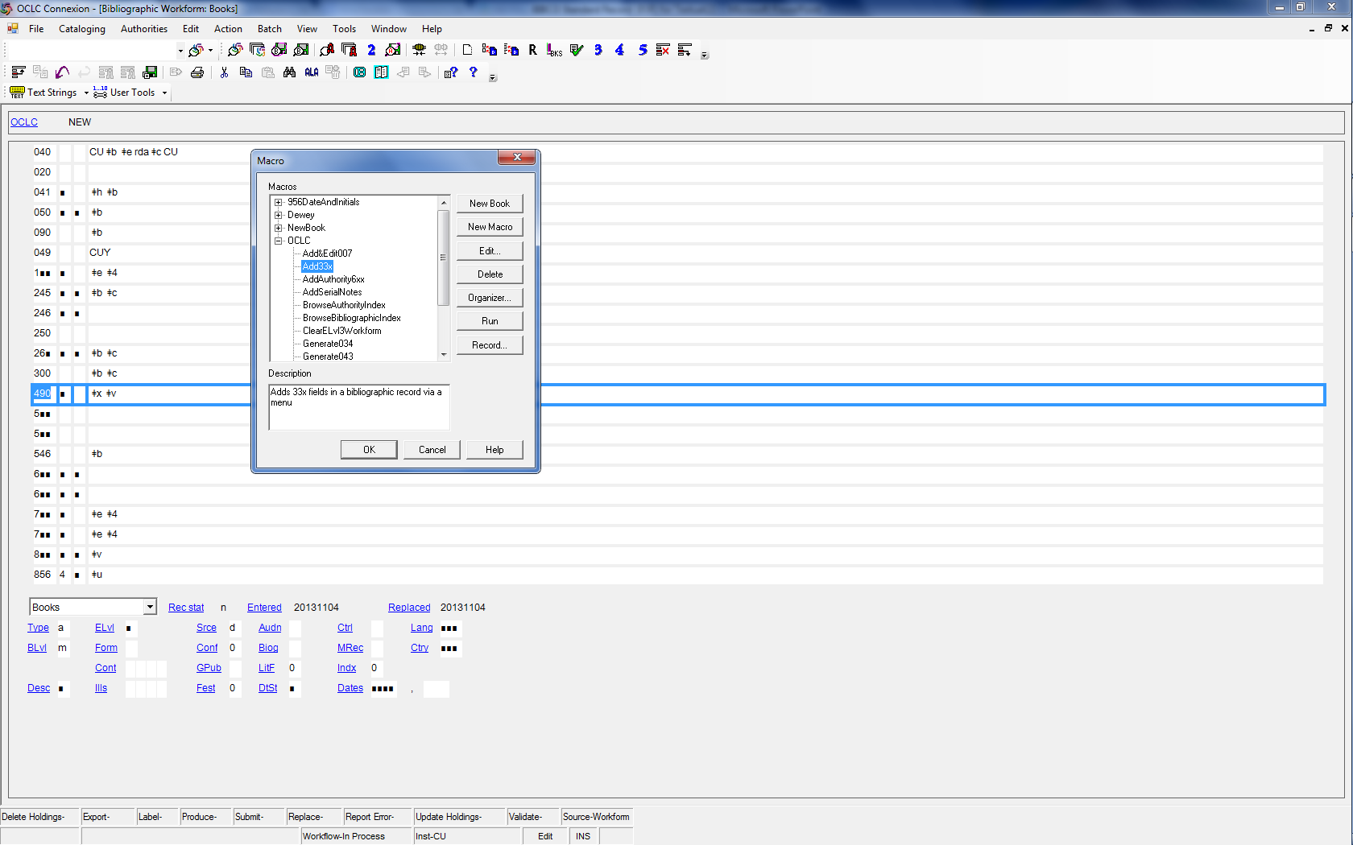
Notes:
Macro should be in the OCLC macro book/directory; it’s called “Add33x”

Slide 54
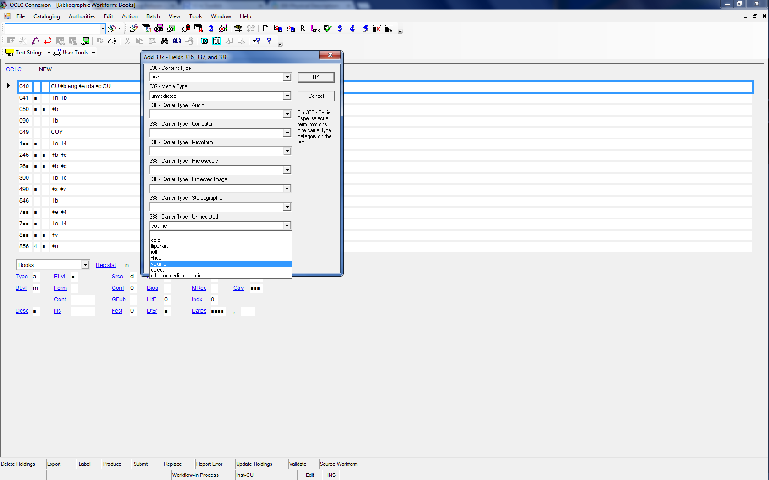
Notes:
Running the macro brings up a dialog box; possible values for each field are available in drop down menus;
The default values are for printed text.

Slide 55
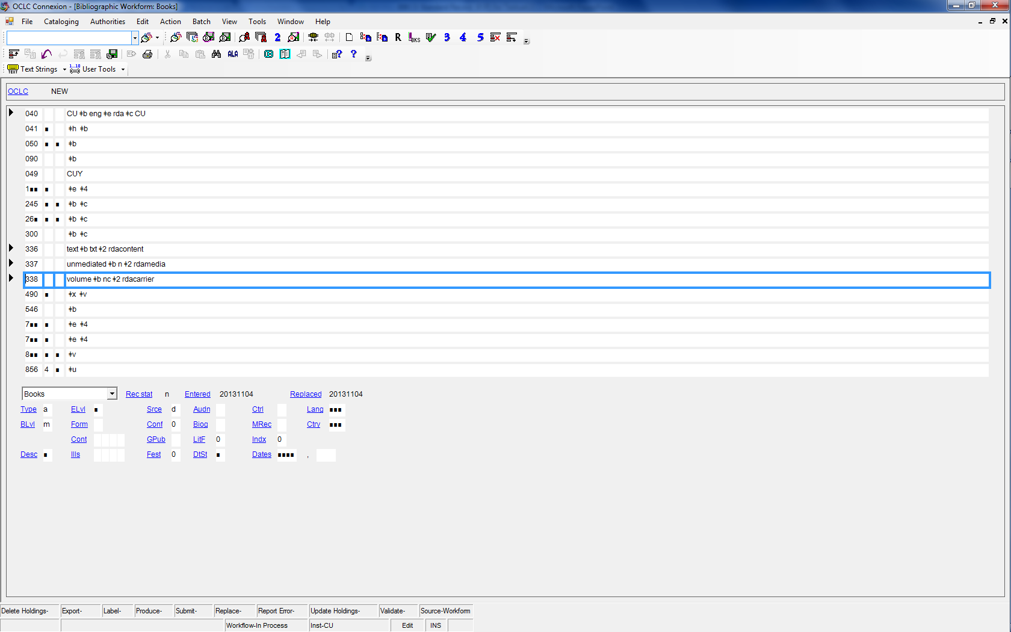
Notes:
Running the macro inserts the fields with the appropriate terms and codes in the record

Slide 56
Cataloging Examples
Please fill in applicable MARC tags on workforms for Examples B, C and E
Notes:
Please record the 3xx fields for Cat. Examples

Slide 57
Example B
Type a ELvl I Srce Audn Ctrl Lang eng
BLvl m Form Conf 0 Biog MRec Ctry enk
Cont b GPub LitF 0 Indx 1
Desc i Ills Fest 0 DtSt s Dates 1999 ,
040 CUY ǂb eng ǂe rda ǂc CUY
020 9780631206996 (alk. paper)
245 0 4 The Third Reich : ǂb the essential readings / ǂc edited by Christian Leitz ; advisory editor: Harold James.
264 1 Oxford, UK : ǂb Blackwell Publishers, ǂc 1999.
xii, 307 pages ; ǂc 24 cm.
336 text ǂb txt ǂ2 rdacontent
337 unmediated ǂb n ǂ2 rdamedia
338 volume ǂb nc ǂ2 rdacarrier
Notes:
No preference given by typography to the U.S. place; Oxford is first so ok to just give Oxford (could also choose to give Malden—cataloger’s judgment/preference
First published 1999 plus copyright date sufficient to take as publication date.
Period at end of cm. because there will be a series statement

Slide 58
Example C
Type a ELvl I Srce d Audn Ctrl Lang eng
BLvl m Form Conf 0 Biog MRec Ctry nyu
Cont b GPub LitF 0 Indx 0
Desc i Ills a Fest 0 DtSt s Dates 2007 ,
040 CUY ǂb eng ǂe rda ǂc CUY
020 9780975392102
041 0 eng ǂa fre
245 0 0 Dan Walsh : ǂb paintings.
246 3 0 Paintings
264 1 New York : ǂb Paula Cooper Gallery, ǂc 2007.
112 pages : ǂb illustrations ; ǂc 24 x 28 cm
text ǂb txt ǂ2 rdacontent
336 still image ǂb sti ǂ2 rdacontent
337 unmediated ǂb n ǂ2 rdamedia
338 volume ǂb nc ǂ2 rdacarrier
Notes:
Arguably, illustrations are significant and predominant, but illustrations are not core; neither is color.
However; we could also argue adding a 336 for content type still image

Slide 59
Example E
Type a ELvl I Srce Audn Ctrl Lang eng
BLvl m Form Conf 0 Biog MRec Ctry enk
Cont bc GPub LitF 0 Indx 1
Desc i Ills Fest 0 DtSt s Dates 1981 ,
040 CUY ǂb eng ǂe rda ǂc CUY
020 9780824095536
110 2 British Library. ǂb Reference Division, ǂe author.
245 1 0 Catalogue of books and periodicals on Estonia in the British Library Reference Division / ǂc compiled by Salme Pruuden ; edited by Dalibor B. Chrástek, Christine G. Thomas.
246 3 Catalog of books and periodicals on Estonia in the British Library Reference Division
264 1 London : ǂb The British Library, ǂc 1981.
309 pages ; ǂc 23 cm.
336 text ǂb txt ǂ2 rdacontent
337 unmediated ǂb n ǂ2 rdamedia
338 volume ǂb nc ǂ2 rdacarrier
Notes:
Pretty standard; all available from the title page; as much of what you do will be.

Slide 60
490 $a
Title proper of series; title proper of a subseries
Manifestation attribute
RDA 2.12.2; 2.12.10
Core
LC PCC PS has guidance, but nothing much changed from AACR2.
Titles are transcribed elements.
Notes:
There is an extensive LC PCC PS for 2.12, but it doesn’t present much new with RDA;
Note that the series statement is an attribute of a manifestation; instructions on tracing the series are in the RDA chapter on related works, expressions etc.

Slide 61
490 $x
ISSN of series
Manifestation attribute
RDA 2.12.8
Core for LC/PCC
Record if present on the resource
If ISSN of a subseries as well as the main series appears record both.
Notes:
Core element for LC/PCC; RDA allows the option to record only the issn of a subseries but a PS says not to apply it. Record both.

Slide 62
490 $v
Numbering of series; Numbering of a subseries
Manifestation attribute
RDA 2.12.9; 2.12.17
Core
Transcribed element; plus apply guidelines on numbers expressed as numerals or as words (see RDA 1.8).
Notes:
Instructions in the LC/PCC PS present not much changed from AACR2.

Slide 63
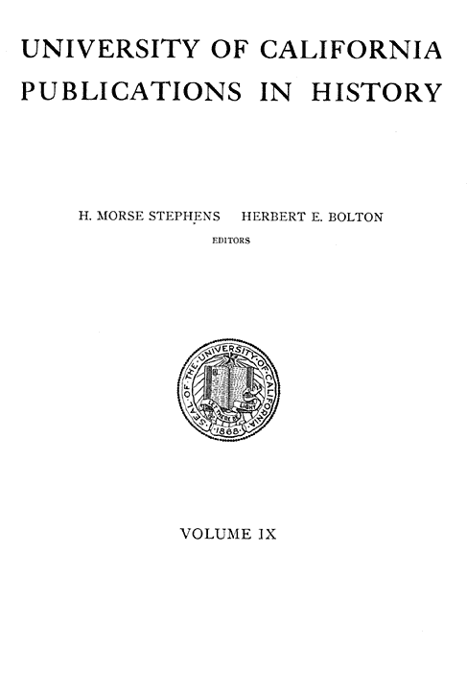
490 1 University of California publications in history ; $v volume IX

Slide 64
500
Notes on manifestation or item
Manifestation/Item attributes
RDA 2.20; RDA 3.22
Not core (except source of title and part of MVM used for identification)
Instructions cover notes on MI only.
Some additional core for resources other than print monographs.
Notes:
Instructions on making notes on manifestation/item ONLY
Information relating to elements of WE may also be recorded in note fields (we will go over some later); be aware that RDA 2.20 is not a complete set of instructions on the kind of notes that may appear in RDA records.
The only notes on manifestations that are core for regular print monographs in the BSR are those noting source of title proper if other than the prescribed source, and part other than the first of a multipart resource used to identify that resource.

Slide 65
501
Related item (“bound withs”)
Item relationship
RDA 28.1
Core element at UCB for “bound with” items
Use for items bound together subsequent to publication.
Use “structured description”
See AskTico instructions on “bound withs” for form of note.
Add $5 CU
Notes:
The 501 is used to record “bound with” relationships between items bound together subsequent to publication
Structured description approach recreates the elements of a bibliographic description of the related item in the note.
Follow AskTico document “Cataloging Bound-With Monographs”

Slide 66
501
100 1 Keyes, Edward Lawrence, ǂd 1899-1990, ǂe author.
245 1 0 Ellis Fischel, M.D., 1883-1938 : ǂb St. Louis surgeon, pioneer-warrior against cancer : a biography / ǂc by Edward Lawrence Keyes, M.D. ; prepared for the Memorabilia Committee of the Jewish Hospital of St. Louis and the Jewish Historical Committee of the Women's Division of the Jewish Federation of St. Louis.
264 0 [Columbia, Mo.?] : ǂb [David N. Carr?], ǂc [between 1958 and 2013]
300 45 leaves ; ǂc 30 cm.
…
500 Typescript (photocopy).
501 Bound with: History of Ellis Fischel State Cancer Hospital / Virnelle Craig Doyle. ǂ5 CU
…
Notes:
Example of a 501 for a separately cataloged, unpublished resource that was bound with an item

Slide 67
502
Dissertation/thesis information
Work attribute
RDA 7.9
Core element for LC/PCC
Record Degree, granting institution and year granted
Use 502 subfields with no intervening punctuation
Notes:
Thesis/Dissertation information is part of describing content of the work.
The 502 is core for LC/PCC if the information is on the resource, regardless of whether the resource represents the actual thesis presented.
If the resource is called a thesis but specific information is lacking, use the 500 with wording such as “Presented as the author’s thesis”.

Slide 68
502
UNIVERSITY OF CALIFORNIA, SAN DIEGO
SAN DIEGO STATE UNIVERSITY
Psychosocial Mediators of Ethnic Disparities in Allostatic Load
A dissertation submitted in partial satisfaction of the requirements for the degree Doctor
of Philosophy
in
Clinical Psychology
by
Lianne M. Tomfohr
Committee in charge:
University of California, San Diego
Professor Joel E. Dimsdale, Chair
Professor Paul Mills
Professor Loki Natarajan
San Diego State University
Professor Linda Gallo
Professor Elizabeth Klonoff
2013
100 1 Tomfohr, Lianne Marie, ǂe author.
245 1 0 Psychosocial mediators of ethnic disparities in allostatic load / ǂc by Lianne M. Tomfohr.
…
502 ǂb Ph. D. ǂc University of California, San Diego and San Diego State University ǂd 2013
Notes:
Note differences from format of 502 in AACR2: now use subfields, degree first and no punctuation.

Slide 69
505
Related work
Work relationship
RDA 25.1
Core for compilations
Use to record works included in a compilations.
Takes the “structured description” approach to referencing related works.
See LC/PCC PS 25.1 for specifics on constructing the 505
Notes:
A 505 contents note is always an option, but is an LC/PCC required core element for compilations (unless there is no collective title and the works are identified in the 245 e.g.) unless “burdensome”;
Also give 7xx for the first or most predominant work if there is one—this will come up later.
505 corresponds to “structured description” method of referencing related works.
The LC/PCC PS for 25.1 gives detailed instructions on how to structure the 505 for compilations. Note that LC/PCC both include a “where not burdensome” clause to be exercised at cataloger’s discretion.

Slide 70
LC-PCC PS 25.1
For compilations of works…Generally, it is not necessary to give contents notes for anthologies of poetry, hymnals, conference proceedings, journals, collections of interviews or letters, chapters of multivolume monographs cataloged as monographic sets and similar resources.
Notes:
Accept in copy but it is not necessary to supply.

Slide 71
505
245 0 4 The third Galaxy reader / ǂc edited by H.L. Gold.
246 1 4 Third Galaxy reader : ǂb fifteen soaring, exciting, unpredictable stories about the world of outer space
…
505 0 0 ǂt Limiting factor / ǂr Theodore R. Cogswell -- ǂt Protection / ǂr Robert Sheckley -- ǂt The Vilbar Party / ǂr Evelyn E. Smith -- ǂt End as a world / ǂr F.L. Wallace -- ǂt Time in the round / ǂr Fritz Leiber -- ǂt Help! I am Dr. Morris Goldpepper / ǂr Avram Davidson -- ǂt A wind is rising / ǂr Finn O'Donnevan -- ǂt Ideas die hard / ǂr Isaac Asimov -- ǂt Dead ringer / ǂr Lester Del Rey -- ǂt The haunted corpse / ǂr Frederik Pohl -- ǂt The model of a judge / ǂr William Morrison -- ǂt Man in the jar / ǂr Damon Knight -- ǂt Volpla / ǂr Wyman Guin -- ǂt Honorable opponent / ǂr Clifford D. Simak -- ǂt The game of rat and dragon / ǂr Cordwainer Smith.
Notes:
Subfielding is good but not required.

Slide 72
546 $a
Language of the content
Expression attribute
RDA 7.12.1
Core for LC/PCC
LC/PCC core if resource has content in two or more languages
Also code in 041
Notes:
Core component satisfied by the LANG fixed field, however;
Field 546 is used to record languages other than the primary language of the content(which is recorded in the Lang fixed field and 500 respectively); record here and in 041;

Slide 73
546 $b, $3
Script
Expression attribute
RDA 7.13.2
Core for LC/PCC
LC/PCC core element for scripts that are not the primary one used with the language
LC PCC PS 7.13.2. instructs to use English names of scripts
If some, but not all content in another script use $3 to specify part.
Notes:
script is core if present in the resource and not the script primarily used with the language in question.
$3 is used to indicate to what part of the content the note applies.

Slide 74
6xx
Subject of a Work
COEP/PFC Relationships
RDA 23
Core for PCC in the BSR
To be developed after the initial release of RDA
In the meantime go with BSR MAP language
650, 651—COEP; LCSH
600, 610, 611—PFC; NAF
Notes:
Instructions on identifying COE are also under development;
instructions on identifying places exist (16), but constructing AAPs for places also awaiting development, but there is an LC PCC PS.
Go to BSR MAP language
Use LCSH to identify concept, object, event and place headings that relate to the work manifested in the resource;
AAP’s in 600 and 610 for PFCs that have a subject relationship to the work(s) manifested in the resource.

Slide 75
700/710/711
Creator
PFC/Work relationships
RDA 19.2
Not core
For creators in addition to one with principal responsibility or first-named on a resource according to cataloger’s judgment.
Use an AAP for the PFC
Use a relationship designator from App. I.2.1
Many examples of various situations in RDA 19.2.1.3
Notes:
What we called added entries in AACR2
Not core but PCC recommends according to catalogers judgment
Relationship designators are also not core, but please provide if possible.

Slide 76
700/710/711
049 CUYM
100 1 Erikson, Erik H. ǂq (Erik Homburger), ǂd 1902-1994, ǂe author.
245 1 0 Vital involvement in old age / ǂc Erik. H. Erikson, Joan M. Erikson, Helen Q. Kivnick.
…
700 1 Erikson, Joan M. ǂq (Joan Mowat), ǂe author.
700 1 Kivnick, Helen Q., ǂe author.
Notes:
You may recall this one;
Collaboration w/o principal responsibility; 700’s are added according to cataloger’s judgment

Slide 77
700/710/711
Other PFC associated with a WORK
PFC/Work relationships
RDA 19.3
Not core
PFC’s associated at the work level but not as creators.
Use an AAP for the PFC
Use a relationship designator from App. I.2.2
Notes:
The list at App. I.2.2 gives an idea of what kind of other relationships with a work can exist; most only rarely apply to print monographs.
Is core for PCC if the PFC is used to construct the AAP for the work (i.e. there is no other creator)

Slide 78
700/710/711
Contributor
PFC/Expression relationships
RDA 20.2
Not core
PFC’s associated at the expression level.
PCC recommended if useful for identification.
Use an AAP for the PFC
Use a relationship designator from App. I.3.1
Notes:
Core for LC for illustrators of juvenile materials
RDA includes instructions for PFC relationships at the manifestation and item level; but none of these are Core for print monographs, or recommended to include in the BSR so we won’t be covering them today.

Slide 79
700/710/711
100 1 Mailer, Norman, ǂe author.
240 1 0 Essays. ǂk Selections
245 1 0 Mind of an outlaw : ǂb selected essays / ǂc Norman Mailer ; edited and with a preface by Phillip Sipiora ; introduction by Jonathan Lethem.
…
700 1 Sipiora, Phillip, ǂe editor of compilation.
700 1 Lethem, Jonathan, ǂe writer of introduction.
700 1 Sipiora, Phillip, ǂe writer of preface.
Notes:
Although not core it is recommended to add AAP’s for Sipiora, and Lethem
Optionally we could add an additional 700 for Sipiora as the writer of the preface.

Slide 80
730/7XX $t
Related work
Work relationships
RDA 25.2
Core for compilations
Give analytical AAP for predominant or first work in a compilation if it represents a significant part of the resource.
Use $i for relationship designators.
Take relationship designators from App. J
PCC recommends entries for additional works if useful for identification.
Notes:
In AACR2 this was the Title added entry and Name-title added entry.
Use $j as the subfield for the relationship designator in a 711/$t
Appx. J lists designators for a range of work-to-work relationships; the only one that is core is the whole-part relationship (J.2.4), and the designator is “$i Contains (work):”

Slide 81
730/7XX $t
100 1 Fallis, Terry, ǂe author.
240 1 0 Novels. ǂk Selections
245 1 4 The Terry Fallis 3-book collection / ǂc Terry Fallis.
246 3 Terry Fallis three-book collection
…
505 0 The best laid plans -- The high road -- Up and down.
…
700 1 2 ǂi Contains (work): ǂa Fallis, Terry. ǂt Best laid plans.
700 1 2 ǂi Contains (work): ǂa Fallis, Terry. ǂt High road.
700 1 2 ǂi Contains (work): ǂa Fallis, Terry. ǂt Up and down.
Notes:
If the High Road and Up and down were shorter and lesser known, could also elect to record the AAP for only Best laid plans.

Slide 82
730/7XX $t
Related expression
Expression relationships
RDA 26.1
Core for LC/PCC for compilations
Give analytical AAP for predominant or first expression in a resource containing two or more expressions.
Give analytical AAP for original language expression and one translation included in a compilation.
Record a relationship designator from App. J.3.4
Notes:
AAP for the original and first translation (which would be related expression) in a resource that contains the original and one or more translations.
App. J.3.4 is for the whole-part expression relationship; $i Contains (expression):

Slide 83
730/7XX $t
…
100 1 Blackstone, Stella, ǂe author.
245 1 0 Bear's birthday = ǂb L'anniversaire de l'Ours / ǂc Stella Blackstone ; illustrations, Debbie Harter ; translated by Elizabeth Parker.
…
Text in English with parallel French translation.
…
700 1 2 ǂi Contains (expression). ǂa Blackstone, Stella. ǂt Bear's birthday.
700 1 2 ǂi Contains (expression). ǂa Blackstone, Stella. ǂt Bear's birthday. ǂl French.
Notes:
A compilation of the original English work and a parallel expression in French;
Record the AAP for the original work in English and AAP for the expression in French

Slide 84
775/776
Related manifestation
Manifestation relationships
RDA 27.1
Core for LC/PCC for reproductions
LC PCC PS 27.1.13: 775 if carrier is the same; 776 if carrier is different (e.g. microform of a paper book)
Set indicators to 08
Use relationship designator "Reproduction of (manifestation)” or others in app. J.4.2 in $i
Notes:
Reproductions include photocopies, reprints, microform reproductions, facsimiles etc.;
The 775/776 gives a “structured description” (elements of the bibliographic record) of the original manifestation.
Use the term “Reproduction of (manifestation) from app. J4 in the $i

Slide 85
Variable data fields: 7xx (cont.)
100 1 Nolen, John, ǂd 1869-1937, ǂe author.
245 1 0 Civic survey, Charlotte, North Carolina : ǂb report to the Chamber of Commerce / ǂc by John Nolen, City Planner, Cambridge, Mass.
…
264 1 [Ithaca, New York] : ǂb [Department of Manuscripts & University Archives, Cornell University Libraries], ǂc [between 2000 and 2010]
300 63 leaves in various numberings : ǂb maps ; ǂc 28 cm
…
500 Photocopy.
…
775 0 8 ǂi Reproduction of (manifestation): ǂa Nolen, John, 1869-1937 ǂt Civic survey, Charlotte, North Carolina ǂd [Charlotte, North Carolina?] : [publisher not identified], [1917] ǂh 63 pages in various pagings : maps ; 28 cm.

Slide 86
830/810/800
Related work
Work relationships
RDA 25.0
Not core
AAP for the series in a series statement on the resource
LC PCC PS 25.0; policy unchanged from AACR2
No relationship designator used.
Notes:
The 8xx tag continues to be used to trace series if resource indicates it is part of an established series that is traced.
If there is more than one expression of the series, e.g. a translation or spoken word recordings of the same series of works there could also be a related AAP for an expression
LC PCC PS for 6.27 gives LC and PCC policy regarding tracing series, which essentially has not changed: LC no longer traces series, established or not, and PCC says doing so is optional.
Technically the 8xx should include a relationship designator for a whole/part
RDA 24.6 instructs numbering in subfield v of the 8xx should follow conventions for recording numerals and using abbreviations as spelled out in RDA 1.8, and appendix B respectively. Of course the form of numbering should be recorded in the AAP record for the series, so follow that. There is a moderately extensive section on recording numbering for series at LC PCC PS 24.6, but it does not specify anything new.

Slide 87
Cataloging Examples
Please fill in applicable MARC tags on workforms for Examples B, C and E
Notes:
Please record the 3xx fields for Cat. Examples

Slide 88
Example B
Type a ELvl I Srce Audn Ctrl Lang eng
BLvl m Form Conf 0 Biog MRec Ctry enk
Cont b GPub LitF 0 Indx 1
Desc i Ills Fest 0 DtSt s Dates 1999 ,
040 CUY ǂb eng ǂe rda ǂc CUY
020 9780631206996 (alk. paper)
245 0 4 The Third Reich : ǂb the essential readings / ǂc edited by Christian Leitz ; advisory editor: Harold James.
264 1 Oxford, UK : ǂb Blackwell Publishers, ǂc 1999.
xii, 307 pages ; ǂc 24 cm.
336 text ǂb txt ǂ2 rdacontent
337 unmediated ǂb n ǂ2 rdamedia
338 volume ǂb nc ǂ2 rdacarrier
490 1 Blackwell essential readings in history
505 0 [?burdensome?]
700 1 Leitz, Christian, ǂe editor of compilation.
700 1 James, Harold, ǂd 1956- ǂe editor.
830 0 Blackwell essential readings in history.
Notes:
Series is a bit of a trick question since not found on the example (except in CIP, which doesn’t count)
505 is similar, but likely you might have one since this is a compilation.
Also since it is a compilation of selected readings I would use editor of compilation for Leitz
No predominating related work contained in this, so no 700$t entry for related work.

Slide 89
Example C
Type a ELvl I Srce d Audn Ctrl Lang eng
BLvl m Form Conf 0 Biog MRec Ctry nyu
Cont b GPub LitF 0 Indx 0
Desc i Ills a Fest 0 DtSt s Dates 2007 ,
040 CUY ǂb eng ǂe rda ǂc CUY
020 9780975392102
041 0 eng ǂa fre ǂh eng
245 0 0 Dan Walsh : ǂb paintings.
246 3 0 Paintings
264 1 New York : ǂb Paula Cooper Gallery, ǂc 2007.
112 pages : ǂb illustrations ; ǂc 24 x 26 cm
text ǂb txt ǂ2 rdacontent
336 still image ǂb txt ǂ2 rdacontent
337 unmediated ǂb n ǂ2 rdamedia
volume ǂb nc ǂ2 rdacarrier
505 2 Dan in the World / Stephen Ellis -- Dan Walsh in conversation / Bob Nickas -- Continuous Abstraction / Eric de Chassey.
English with French translation ǂ3 Essays and interview.
700 1 ǂi Contains (work): Walsh, Dan, ǂd 1960- ǂt Paintings. ǂk Selections.
700 1 ǂi Contains (expression): ǂa Ellis, Stephen, ǂd 1951- ǂt Dan in the world. ǂl English.
700 1 ǂi Contains (expression): ǂa Chassey, Éric de. ǂt Continuous abstraction. ǂ English.
700 1 ǂi Contains (expression): ǂa Walsh, Dan, ǂd 1960- ǂt Dan Walsh in conversation. ǂl English.
700 1 ǂi Contains (expression): ǂa Ellis, Stephen, ǂd 1951- ǂt Dan in the world. ǂl French.
700 1 ǂi Contains (expression): ǂa Chassey, Éric de. ǂt Continuous abstraction. ǂl French.
700 1 ǂi Contains (expression): ǂa Walsh, Dan, ǂd 1960- ǂt Dan Walsh in conversation. ǂl French.
Notes:
If treated as a compilation.
7xx are AAP’s for the French language expressions of those works.

Slide 90
Example E
Type a ELvl I Srce Audn Ctrl Lang eng
BLvl m Form Conf 0 Biog MRec Ctry enk
Cont bc GPub LitF 0 Indx 1
Desc i Ills Fest 0 DtSt s Dates 1981 ,
040 CUY ǂb eng ǂe rda ǂc CUY
020 9780824095536
110 2 British Library. ǂb Reference Division, ǂe author.
245 1 0 Catalogue of books and periodicals on Estonia in the British Library Reference Division / ǂc compiled by Salme Pruuden ; edited by Dalibor B. Chrástek, Christine G. Thomas.
246 3 Catalog of books and periodicals on Estonia in the British Library Reference Division
264 1 London : ǂb The British Library, ǂc 1981.
309 pages ; ǂc 23 cm.
336 text ǂb txt ǂ2 rdacontent
337 unmediated ǂb n ǂ2 rdamedia
338 volume ǂb nc ǂ2 rdacarrier
490 1 Garland reference library of social science ; ǂv vol. 71
700 1 Pruuden, Salme, ǂe compiler.
700 1 Chrástek, Dalibor B., ǂe editor.
700 1 Thomas, Christine G., ǂe editor.
830 0 Garland reference library of social science ; ǂv v. 71
Notes:
Series info only available on actual book.
Pruuden is a work level creator
Expression level relationships for Chrastek and Thomas

Slide 91
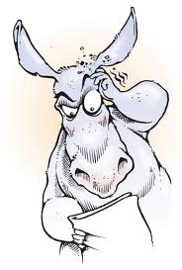
QUIZ

Slide 92
QUIZ
1.
100 1_ $a Swanson, Carroll. _not acceptable___
100 1_ $a Swanson, Carroll, $e author.­­­­­­­­­­­­­­­­­­­­­­­­­­­­­­­­ __preferred RDA____
100 1_ $a Swanson, Carroll, $e contributor. _not acceptable_
100 1_ $a Peterson, Ann. _not acceptable____
No 100 field ___AACR2________
Notes:
Rule of three in AACR2
Title ME in AACR2
Expression level relationship designator for creator
Rule of three in AACR2 and not principal or first named for RDA
Rule of three in AACR2; title main entry

Slide 93
QUIZ
2.
245 00 $a Montgomery County : $b an illustrated history / $c Carroll Swanson … [et al.] __AACR2_______
245 10 $a Montgomery County / $c Carroll Swanson, Donna Hallquist, Denise Anderson, Ann Peterson. __not acceptable_
245 10 $a Montgomery County : $b an illustrated history / $c Carroll Swanson, Donna Hallquist [and two others]. __RDA_______
245 10 $a Montgomery County : $b an illustrated history / $c Carroll Swanson, Donna Hallquist, Denise Anderson, Ann Peterson. ___RDA____
Notes:
Rule of three in AACR2
Other title core for PCC/BSR
Truncate with description in brackets
Also ok for RDA

Slide 94
QUIZ
3.
245 10 $a NUTRITION AND DIABETES / $c by Dr. Logan Ramsey, Johns Hopkins University Hospital and Linda Smits, Ph.D., University of Wisconsin. __RDA____
245 10 $a Nutrition and diabetes / $c by Logan Ramsey and Linda Smits. __RDA ___
245 10 $a Nutrition and diabetes / $c by Dr. Logan Ramsey, Johns Hopkins University Hospital and Linda Smits, Ph.D., University of Wisconsin ; research assistance by Philip Gordon, Georgetown University. __RDA__
Notes:
All acceptable for RDA copy, but not preferred for original;
none acceptable for AACR2;
RDA preferred would include second statement of responsibility.

Slide 95
QUIZ
4.
250 __ $a 2nd ed. __AACR2___
250 __ $a 2nd edition. __not acceptable___
250 __ $a Second edition. __RDA preferred___
Notes:
RDA transcribed element--TWYS

Slide 96
QUIZ
5.
260 __ $a [Baltimore, Md.] : $b Johns Hopkins University Press ; $a Falls Church, Va. : $b Distributed by RN, Incorporated, $c c2011. __AACR2_____
264 _1 $a [Baltimore, Md.] : $b Johns Hopkins University Press ; $a Falls Church, Va. : $b Distributed by RN, Incorporated, $c [2011] __not acceptable__
264 _1 $a [Baltimore, Md.] : $b Johns Hopkins University Press, $c [2011] __RDA preferred__
264 _1 $a [Place of publication not identified] : $b Johns Hopkins University Press , $c [2011] 264 _ 2 $a Falls Church, Va. : $b Distributed by RN, Incorporated __RDA__
Notes:
d. Not preferred because naming distributor goes beyond core if publisher name is present.

Slide 97
QUIZ
6.
100 1_ $a Kutschenreutter, Christopher, $e author. 245 10 $a Kutschenreutter's four novels / $c Christopher Kutschenreutter ; edited by Lisa Blackmon. ___AACR2___
100 1_ $a Kutschenreutter, Christopher, $e author. 240 10 $a Sally's gift [and three other novels] __not acceptable_
100 1_ $a Kutschenreutter, Christopher, $e author. 240 10 $a Novels __RDA preferred__
100 1_ $a Kutschenreutter, Christopher, $e author. 240 10 Works. $k Selections __not acceptable__

Slide 98
QUIZ
7.
240 10 $a Vägmärken. $l English __both, RDA preferred___
700 10 $i Translation of: $a Hammarskjöld , Dag. $t Vägmärken . __RDA____
500 __ $a Translation of Vägmärken. _AACR2__
500 __ $a Translation of (manifestation): Vägmärken / Dag Hammarskjöld. -- [Sweden] : Albert Bonniers Förlag, AB, 1963. ___not acceptable___
Notes:
b. Identifies the work (original language)-acceptable RDA (still need 240 to identify expression, however)
d. Translation is an expression-level relationship only

Slide 99
QUIZ
8.
264 _1 $a New York : $b UN Press, $c [2011] _not acceptable__
260 __ $a New York : $b UN, $c 1990 [2011 printing] _AACR2__
264 _1 $a New York : $b UN Press, $c 2009. 264 _3 $c 2011. __RDA__
264 _1 $a New York : $b UN Press, $c 2009. 588 __ $a Description based on 32nd printing, 2011. RDA preferred_
Notes:
a. 2011 is date of manufacture, not publication date
c. Ok for RDA, but the 264_3 is not core
d. Preferred, but 588 is optional.

