Slide 1
Authorized Access Points
Or, How I learned to stop worrying and love RDA
Notes:
Intro.

Slide 2
Learning Objectives For the 1st Segment
•Increased familiarity with the philosophical ins and outs of authorities and AAPs (Authorized Access Points; formerly known as “headings”) in RDA
•Have a general idea of how RDA authorities are different (and the same!) from authorities under AACR2
•Have general understanding of how to use authorities
•How to formulate AAPs in the absence of an authority
•Where to find out more when you need it
Notes:
The first segment aims to increase familiarity with the philosophical ground work of authorities and AAP’s, learn the differences between authorities under AACR2 and the new regime, on-the-fly AAP formulation, and which resources are available when one has questions.

Slide 3
Terminological prolog
AACR2 : Heading
RDA : Authorized Access Point = AAP
When I say “record,” I mean “authority record.” When I mean “bibliographical record,” I will say as much. If I slip (and I may), ask.
PFC: Person, Family, or Corporate Body

Slide 4
FRAD
Functional
Requirements for
Authority
Data
Extension to FRBR delineating what authorities do
Notes:
This is the acronym, and what is represents. What it actually means comes next.

Slide 5
Those principles?
1. Find
2. Identify
3. Clarify/Justify
4. Contextualize
Notes:
This is the plotline behind authorities, stated in clear bullet points. The next slide gives a coherent English summation.

Slide 6
What it means
The meaning is simple: authority records function pretty much as they did under AACR2. Under RDA however, the principles of identification and contextualization have a much more prominent place and authorities have been expanded to accommodate this re-emphasis.
Notes:
A summation. In the next few slides we’ll be looking at the points of divergence and contact between AAVR2 and RDA.

Slide 7
And that leads to …
Notes:
And that leads to …

Slide 8
RDA vs. AACR2
Notes:
Oh no! It’s Mecha-Godzilla! And he’s up to no good!

Slide 9
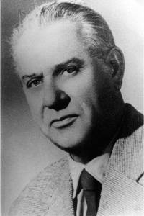
Meet Fekete István
Fekete István, 1900-1970, was a celebrated Hungarian author in the mid-20th century who wrote novels for young people and animal stories. We’ll be looking at his authority record on and off for the next few slides

Slide 10
An Example of an authority record

Slide 11
The things that are the same
•Authorities still do what they have always done, and all of the old fields are still pretty much the same.
•Authorities are still used in the bib records in pretty much the same way
•OCLC still allows for controlling authorities and bibs
Notes:
The good news is that so much of what we did with authorities in the past is still alive and well in RDA.

Slide 12
The things that are different
•There are a host of new MARC fields in authority records
•An expanded role and list of distinguishing terms and conventional collective titles for works/expressions/uniform titles
•Changes to fixed fields and 040
•Dates and 046
•Family records
•An increased number of Works/Expressions authorities
Notes:
The not-so bad news is that there a few things that are new. In the vein of adding more re. find, identification, clarify, and contextualization, all of our new fields do these things. A blow by blow account is on the following slides.

Slide 13
New MARC fields
• For all authorities
046 dates
370 associated place
372 field of activity
373 associated group
377 language
• Personal names only
374 occupation
375 gender
378 fuller form of name
• Personal names and Corporate bodies
- 368 other attributes of person or corporate body
• Family names only
376 family information
• Works, expressions only
- 336 content
- 380 form of work
- 381 other characteristics
•Music only
382 medium of performance
383 numeric designation
384 key
Notes:
Handout! These are the new fields. Find, identify, clarify, and contextualize. That’s what these do, but they will look weird when one encounters them for the first time.

Slide 14
When in doubt
MARC field help in OCLC will answer most of your questions.
DEMO GOES HERE
Notes:
MARC field help, folks. It’s worthwhile and will at least give a ball park estimation of how the field in question is being used it won’t be able to answer all of your questions.

Slide 15
Distinguishing terms and collective titles
• Personal names:
- Professions may now be used to break conflicts
- RDA 9.6.1.9: “other designations”= anything, but only when other categories aren’t available
• Works, expressions, Uniform titles:
- there are no restrictions on which terms to use
• Conventional collective titles
- $t Selections has been eliminated
Notes:
The role of distinguishing terms has increased. For personal names, professions can be used to break conflicts when no other distinguishing data are present. For Uniform titles/Works/Expressions, all of the loose prescriptions of AACR2 are gone, esp. the use of $f date. For conventional collective titles, the greatest change has been the elimination of $t Selections, though $k Selections is still with us.

Slide 16
Fixed fields and 040
The principal mark of distinction between an RDA authority and an AACR2 authority are the designations in the fixed fields and the 040
AACR2 008/10 “Rules”: C
RDA 008/10 “Rules”: Z
AACR2 040: CU $b eng $c CU
RDA 040: CU $b eng $e rda $c CU
Notes:
This is the way to discern between RDA and AACR2 records.

Slide 17
Example: RDA Rules and 040

Slide 18
046 and dates
Dates have become more important and more applicable under RDA. A new MARC field, 046, is used for recording the dates, even if they are not used in the AAP.
Notes:
The 046 is a convenient, machine-friendly way of recording dates, to include birth, death, dates of activity, and the founding and closing dates for corporate entities. MARC field help will be able to answer many questions that arise. If dates are not present when the record is created but later become know, they may justified and added to the 046 without triggering a change to the 1xx or 4xx. This is to say that you will see records that lack dates in the 1xx and 4xx fields, but have a full-on 046 present.

Slide 19
Example: RDA 046

Slide 20
Date notation in the AAP
The notation for recording dates in the AAP has also changed, notably:
•no more b. [date] or d. [date]. Instead “[date]-” to indicate only a known birth date or “–[date]” to indicate a known date of death only
• all abbreviations have been replaced with full words, e.g., “c.” for “circa” has been replaced with “approximately.”
Notes:
The abbreviations are gone. They’ve been replaced by either full terms or by hyphens. The hardest one to get used to is the death date only AAPs, which feature a date preceded by a hyphen. Recall that these dates had been previously described with a date preceded by a “d.”

Slide 21
Authorities for Families
Records for families have in the past been used exclusively as subject headings. Under RDA however families now may be considered creators or subjects, but with discrete records.
Notes:
The good news about families creator authority records is that they are uncommon unless you’re cataloging archival collections. If however you need to use a family creator record, the following tips should help.

Slide 22
Creators or subjects?
Unlike personal names, authorities for families as creators require discrete records from authorities covering the same family as a subject.
Notes:
The basic truth.

Slide 23
Families as subjects
The tell-tale markers
008/14 “Name use”: b (“heading not appropriate for main or added entry”)
008/15 “Subj. use”: a, meaning it is appropriate for subject use.
The word “family” will be appended directly to the AAP and Variant Access Points (VAPs)
e.g. Williams family
4) Is used to refer to all branches
Notes:
While the structure is a clue, the fixed fields will set you on the right course.

Slide 24
Families as creators
The tell-tale markers
008/14 “Name use”: a (“heading appropriate for main or added entry”)
008/15 “Subj. use”: b, meaning it inappropriate for subject use
The word “family” or a related descriptive term will be appended parenthetically to the AAP and Variant Access Points (VAPs)
4) Refers to a specific branch
Notes:
The obverse of the preceding.

Slide 25
Families as creators
Creator authorities for Families have a specific structure where certain terms and facts have to present in a specific order if known
The name of the family
The type of family (family, clan, royal house, or dynasty)
Dates if known
Place if known
Notes:
Key points

Slide 26
Examples of AAPs & subject headings
1003# Aiken family [subject]
1003# Aiken (Family : ǂd 1854-1981 : ǂc Conn.)[creator]
1003# Asher family [subject]
1003# Asher (Family : ǂc Worcester, Mass.) [creator]
1003# Blomstrand family [subject]
1003# Blomstrand (Family: ǂc Sweden) [creator]
And just so you can see the types in action ….
1003# Chichibu no Miya (Royal house) [creator]
1003# Romanov (Dynasty : ǂd 1613-1917) [creator]
Notes:
Here are some examples taken from the AF. In the first three paired examples, the 1st entry is the heading from the subject authority record followed by the word subject in square brackets. This subject heading maybe used for any branch of the Aiken family. Note that the word family is directly appended to the family name. The 2nd is from the creator authority. This AAP may only be used for this specific branch. Note that the type of family, dates [if known], and place if known] are added after the family name in parentheses. The final two examples are included to display uses of other family types in AAPs for creators.

Slide 27
Inquiring minds want to know
The term “clan” is undefined in the instructions, thus I give you the first definition from entry for “clan” in the on-line OED
1. A number of persons claiming descent from a common ancestor, and associated together; a tribe.

Slide 28
Exam #1
The first of two over the course of the day.
Please follow the directions beneath each record.

Slide 29
The answers

Slide 30
But wait! There’s more!
A bit later in this presentation we’ll discuss the ins and outs of creator authorities for families. Be patient, it will come.

Slide 31
More! More! More! Works/Expressions authorities
A tidal wave of authorities representing works/expressions is upon us. RDA’s philosophical reconfiguration of bibliographical description necessitates more control points within bib records, which in turn generates a need for authority control (in an ideal world, anyhow)
Notes:
We’ll be taking a closer look at works/ expressions later. I’ll show examples then and in some of our exercises

Slide 32
On-going changes RDA instructions and the various policy statements are constantly evolving.
Notes:
Indeed they are.

Slide 33
RDA-ization
Programmatically updating AACR2 records to RDA
3 phases, we’re in the third
Previous 2 were done mechanically, the 3rd as encountered by catalogers
Some records only had 667’s inserted to reflect that they would have to be done by hand.
Notes:
Updating demands—we need to discuss; also include something about 677

Slide 34
667s related to updating AACR2 authorities
THIS 1XX FIELD CANNOT BE USED UNDER RDA UNTIL THIS RECORD HAS BEEN REVIEWED AND/OR UPDATED– This one is important and we will see it again.
Machine-derived non-Latin script reference project.
And so on.

Slide 35
Hybrids
Hybrids are records in which the AAP is composed of two distinct portions in which the first portion is controlled by an AACR2 record, but the dual form is RDA.
e.g., University of Colorado, Boulder. ǂb University Libraries
Hybrids are permitted for the time being, though their future seems uncertain. Expect policy changes.
Notes:
-- jurisdictions

Slide 36
Meet the NACO Liaison
He can answer your questions
rtalbott@library.berkeley.edu

Slide 37
Using Authorities
Or, The wonders of being blue

Slide 38
The authorities dance for catalogers

Slide 39
Copy Cataloging
Oh frabjous day! Take what you see!
… Unless there’s an obvious problem (clearly not the right person, etc.). Follow the steps under “Original cat” (we’ll get there in a couple of minutes).
Always remember that in a bind, you may consult the NACO liaison
DON’T PANIC

Slide 40
Deriving and upgrading bibs
Verify AAPs by trying to control them in OCLC
Here’s method I use, but there others
• Move cursor to field to be controlled
• Right click and select from menu and select “Control Single Heading”
• From the “Control headings” dialog box, select the correct heading
• The bib record reappears, and the field turns blue
Notes:
Shift f11?

Slide 41
It’s turning blue!
There’s an authority record there!
Verify that the authority you’ve just linked to is reasonably correct

Slide 42
Reasonably verifying
Look at any biographical description on the piece
Compare with data in authority, esp. 670’s
Authors tend to mine specific veins of knowledge. In the absence of solid biographical confirmation, look at the kinds of books the person writes
Undifferentiated records may be okay. Check with the NACO liaison before using

Slide 43
Undifferentiated authority
Undifferentiated authorities are a special class of authorities that track names for seemingly separate people who, because of lack of resources cannot be distinguished
Distinguishable by the 670 structure:
670## [Author of XYZ]
670## XYZ, 2012: $b t.p. (Jim Smith)

Slide 44
An example of an undifferentiated authority

Slide 45
It’s not turning blue? Or The authority you just linked to is obviously not the one you want?
Don’t panic. We’ll check the authority file, which we’ll get to in a couple of minutes.

Slide 46
Original Cat
The authority file must be checked on OCLC
The authority file must be checked on OCLC
The authority file must be checked on OCLC
The authority file must be checked on OCLC
The authority file must be checked on OCLC
The authority file must be checked on OCLC
The authority file must be checked on OCLC
The authority file must be checked on OCLC

Slide 47
How to check OCLC authorities
There are couple of ways
Browsing: Click on “Authorities” from toolbar then click on “Browse LC names and subjects”. This will meet 90% of your needs
Search: Shift + F2 is one way. Good for dealing with complex lists (e.g. jurisdictions, corporate departments, etc.)
Be sure to use the right index: if you’re looking for a personal, search the “Personal names” index.

Slide 48
You’ve found the right record
You searched the authority file, located a likely record, took a look at it and have decided that in fact it reasonably represents what you’re looking for and it’s RDA
Use it and be done
Remember undifferentiated records? One may be okay, but you might consider checking with the NACO liaison before you use it.

Slide 49
You’ve found the right record but it’s AACR2
• RDA or AACR2 without is okay to use
• But if it’s got a 667 “THIS 1XX FIELD CANNOT BE USED UNDER RDA UNTIL THIS RECORD HAS BEEN REVIEWED AND/OR UPDATED” …
This 667 indicates the AACR2 record is …
non-RDA compatible

Slide 50
It’s quite the pickle
… but we have 2 possible answers
Per our local policy, we may use AACR2 authorities in an RDA bib record if we code the bib as Elvl: K. This will solve most of your problems
Have the NACO liaison upgrade the record

Slide 51
You looked in the AF and found nothing
We have two options when a reasonably appropriate authority can’t be found in the AF
Have the NACO liaison create an authority
Or
2) Float an AAP
Option 1 has a lot of utility, but it’s not appropriate to every situation. When in doubt, ask.

Slide 52
Having a heading created
You checked the Authority files, right?
If nothing is found in Authority File, contact the NACO liaison to get the ball rolling.
The NACO liaison or a related trades-person will need to see the piece where the name is taken from, so keep it nearby.

Slide 53
Floating an AAP
You checked the authority file, right?
If nothing is found in the Authority File, it is permissible to float an AAP.
By “float,” we mean to anticipate what the AAP would like if the correct authority existed (but doesn’t) and to use the same.

Slide 54
How to float an AAP
The key to floating an AAP is anticipating what the AAP would be if there were an authority.
There 4 number of types of headings commonly encountered, each with their own nuances
Personal names
Corporate bodies/Conferences
Works/Expressions/Uniform titles
Families

Slide 55
Something to keep in mind
• 90% of cases people will encounter, only names will be involved—no dates, no professions, etc.
• The particulars are a little different, but this is the same thing we have always done in some cases.
DON’T PANIC

Slide 56
Something else to keep in mind
Finding the right authority can be confusing, but fear not, the NACO liaison is here to help

Slide 57
Floating personal names
You’ve checked OCLC’s Authority File, right?
•Follow the instructions in RDA 9.19 for selecting the preferred form of the name.
•If dates are present on the piece, include them.
•If there is still a conflict with another name in the AF, use an accurate, properly coded distinguishing term, e.g., $c (Plumber). Types of distinguishing terms may be found in 9.19.1.

Slide 58
Floating corporate names
You’ve checked OCLC’s Authority File, right?
• Follow the instructions in RDA 11.13 for selecting the preferred form of the name.
•RDA 11.13.1.2-11.13.1.7 provides terms and elements that may be used to break conflicts
Notes:
Tool kit?

Slide 59
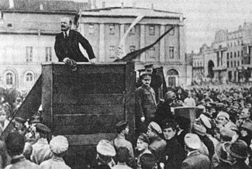
Floating conferences
You’ve checked OCLC’s Authority File, right?
• The instructions for corporate bodies in RDA 11.13 also apply to conferences
• We still use parenthetical numbering, dates, and place when apparent
• Generic conference authority vs. specific conference authority

Slide 60
Floating works/expressions
You’ve checked OCLC’s Authority File, right?
•RDA 6.27-6.31, but mostly RDA 6.27 and 6.30
• Preferred form plus distinguishing term if required
Notes:
We need examples. Explain that this is 240 or 130.

Slide 61
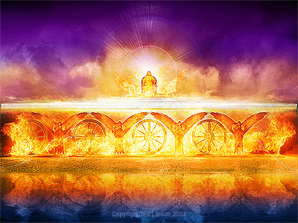
WARNING! WARNING!
The hierarchies for sacred texts have changed
AACR2: Bible.$pO.T.$pEzekiel
RDA : Bible.$p Ezekiel

Slide 62
Floating families
You’ve checked OCLC’s Authority File, right?
• Family name or subject?: do not use the subject AAP for the creator AAP. It does not compute.
• Follow the established algorithm instead: either have an authority created, or float one.
•But Bob, how does one go about “floating” a family name? Can we really do this?

Slide 63
I’m glad you asked
And yes, you may.
• Following RDA 10.10, use the preferred form, which is the surname
• Mandatory: add the family type (RDA 10.3) and date(s) associated with the family in that order inside parentheses
•If required to distinguish: add a place name associated with the family and/or the name of a prominent member, also within the parentheses
Notes:
You can’t say that about Ram Dass!

Slide 64
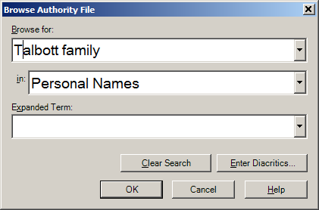
Don’t forget!
Both kinds of Family authorities are indexed under “Personal name” in OCLC

Slide 65
Break?

Slide 66
Learning Objectives For the 2nd Segment
• Be able to distinguish collaborative works from compilations
• Have a general understanding of the various types of collaborations, compilations and the respective consequences (and how these things dramatically tie in with Authorized Access Points)
• Have an understanding of conventional collective titles as they exist within RDA
• And finally, be able to find the appropriate relator term in the RDA Toolkit and use it correctly

Slide 67
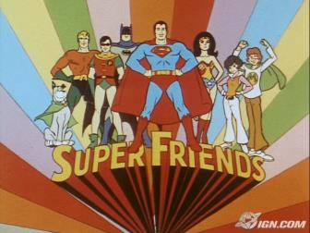
Collaborations vs. Compilations
• Collaborations: RDA 6.27.1.3
• Compilations: RDA 6.27.1.4
Compilation Collaboration

Slide 68
Is it a collaboration?
You have no idea who created what; single work two or more creators
You are in doubt
Creator is either the principal creator or the first mentioned creator
Remember: no more rule of 3!

Slide 69
The 2 kinds of collaborations
With principal responsibility
Without principal responsibility

Slide 70
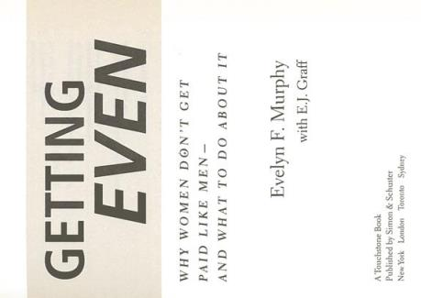
Collaboration with principal responsibility: an actual title page

Slide 71
Collaboration with principal responsibility example
Under AACR2
1001# Murphy, Evelyn F.
24510 Getting even : $b why women don’t get paid like men– and what to do about it / $c Evelyn F. Murphy with E.J. Graff.
7001# Graff, E. J.

Slide 72
Collaboration with principal responsibility example
The RDA version
1001# Murphy, Evelyn F., $e author.
24510 Getting even : $b why women don’t get paid like men– and what to do about it / $c Evelyn F. Murphy with E.J. Graff.
7001# Graff, E. J., $e author.
Good news! It’s just like AACR2, except the 700 entries are optional.

Slide 73
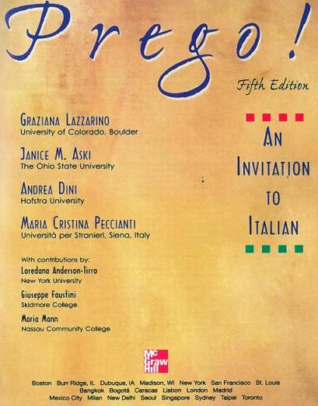
Collaboration without principal responsibility: an actual title page

Slide 74
Collaboration without principal responsibility example pt. 1
Under AACR2
24500 Prego : $b an invitation to Italian / $c Graziana Lazzarino … [et al.].
7001# Lazzarino, Graziana.

Slide 75
Collaboration without principal responsibility example pt. 2
But under RDA the work looks like this:
1001# Lazzarino, Graziana, $e author.
24510 Prego : $b an invitation to Italian / $c Graziana Lazzarino, Janice M. Aski, Andrea Dini, Maria Cristina Peccianti.
7001# Aski, Janice M. , $e author. *
7001# Dini, Andrea , $e author.*
7001# Peccianti, Maria Cristina, $e author.*
*Nice, but not required.

Slide 76
Is it a compilation?
• an indication of who created what (any number of possible creators, from 1 to infinity)
• an indication from somewhere on the piece stating that it qualifies as a compilation, e.g. terminology, an indication on the chief source, table of contents, etc.

Slide 77
The 4 kinds of compilations
Multiple works with 1 creator
Multiple works, multiple creators, and a collective title proper (manifestation)
Multiple works, multiple creators sans collective title proper (manifestation)
Multiple expressions of the same work

Slide 78
Compilation: multiple works by one author
• Treat as compilation since there are no other creators
• Identified by Creator plus preferred title
• Preferred title for 1 creator, multiple works: RDA 6.2.2.10
-Is it known by a Title?
○Not usually, but exceptions like “Leaves of grass” exist. When in doubt, check reference sources.
- Almost all will have a conventional collective title
○ More on this later

Slide 79
Compilation: 1 creator, multiple works example: an actual t.p.

Slide 80
Compilation: 1 creator, multiple works example: what it looks like in AACR2
1001# Dick, Philip K.
24010 Short stories.
24514 The collected stories of Philip K. Dick / $c introduction by Norman Spinrad.
5051# -- Volume two. We can remember it for you wholesale --
7001# Spinrad, Norman.

Slide 81
Compilation: 1 creator, multiple works example: what it looks like in RDA
1001# Dick, Philip K., $e author.
24010 Short stories.
24514 The collected stories of Philip K. Dick / $c introduction by Norman Spinrad.
5051# -- Volume two. We can remember it for you wholesale --
7001# Spinrad, Norman, $e writer of introduction.*
*Optional, but still nice.

Slide 82
Compilation: multiple works by multiple creators with a collective title proper (manifestation)
Remember, we know who has done what, so it’s a compilation
• No principal creator (bet on an editor being present)
Preferred title
Title proper of the manifestation (common)

Slide 83
Compilation: multiple works by multiple creators with a collective title proper (manifestation) t.p.

Slide 84
Compilation: multiple works by multiple creators with a collective title proper (manifestation) AACR2 example
24504 The discerning reader : $b Christian perspectives on literature and theory / $c edited by David Barratt, Roger Pooley, Leland Ryken.
7001# Barratt, David.
7001# Pooley, Roger.
7001# Ryken, Leland.

Slide 85
Compilation: multiple works by multiple creators with a collective title proper (manifestation) RDA example
24504 The discerning reader : $b Christian perspectives on literature and theory / $c edited by David Barratt, Roger Pooley, Leland Ryken.
7001# Barratt, David, $e editor of compilation.
7001# Pooley, Roger , $e editor of compilation.*
7001# Ryken, Leland , $e editor of compilation.*
*Optional.

Slide 86
Compilation: multiple works by multiple creators without a collective title proper (manifestation)
There is no principal creator
For the preferred title, use the title proper (manifestation) of the first work and
Use an analytic AAP for the first or predominant work
Fair warning: this is very different from AACR2 and will break your brain if you’re not careful

Slide 87
Compilation: multiple works by multiple creators without a collective title proper (manifestation)

Slide 88
Compilation: multiple works by multiple creators without a collective title proper (manifestation) example 1
1st, the AACR2 version
1001# Zelazny, Roger.
24510 Home is the hangman/ $c Roger Zelazny. We, in some strange power’s employ, move on a rigorous line / Samuel R. Delany.
500## Title from spine.
70012 Delany, Samuel R. $t We, in some strange power’s employ, move on a rigorous line.

Slide 89
Compilation: multiple works by multiple creators without a collective title example 2
And now, the same book described under RDA
24500 Home is the hangman / $c Roger Zelazny. We, in some strange power’s employ, move on a rigorous line / Samuel R. Delany.
500## Title from spine.
70012 $i Contains (work): $a Zelazny, Roger. $t Home is the hangman.
70012 $i Contains (work): $a Delany, Samuel R. $t We, in some strange power’s employ, move on a rigorous line.

Slide 90
Multiple expressions of same work
LC-PCC PS for 6.27.3: When the original expression and one translation are in a compilation, give an analytical authorized access point for each expression. If a compilation contains the original expression and more than one translation, give analytical authorized access points for the original expression and at least one translation.
This is the one that pays the dividends, folks.

Slide 91
LC PCC PS 6.27.3 Example
The classical example of a compilation of expression of the same work:
Please note that the example does not give any relationship terminology. It’s a bit dated in that regard.

Slide 92
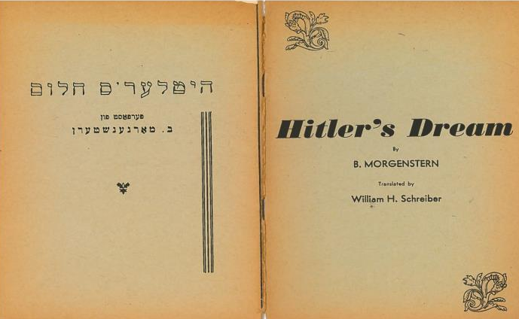
Multiple expressions of same work
The cover of a work in Yiddish with a complete English translation. The Yiddish reads “Hitler’s holem / ferfast fun B. Morgenshtern.”

Slide 93
The record under AACR2
1001# Morgenstern, B.
24010 Hitler’s holem. $l English & Yiddish.
24510 Hitler’s holem / $c ferfast fun B. Morgenshtern.
2461# $i Title from p.4 of cover: $a Hitler’s dream
500## Cover title.
500## Translated by William H. Schreiber.

Slide 94
The same book under the RDA regime
1001# Morgenstern, B., $e author.*
24510 Hitler’s holem = $b Hitler’s dream / $c ferfast B. Morgenshtern ; translated by William H. Schreiber.
2461# $i Parallel title from page 4 of cover: $a Hitler’s dream
70012 $i Contains (expression): $a Morgenstern, B.,
$t Hitler’s holem.
70012 $i Contains (expression): $a Morgenstern, B.
$t Hitler’s holem. $l English.
7001# Schreiber William H., $e translator.
*Notice that there is no 240.

Slide 95
Conferences
Though conference proceedings are essentially collections of essays, they are technically not compilations. Though each of the authors is a discrete individual creating a discrete work, the conference itself is the work (composed of the discrete works) of the body (composed of the discrete authors). Recall that under RDA 11.0 conferences are explicitly defined as corporate bodies.

Slide 96
Conferences
The title page.

Slide 97
Conferences Example
YES
1112# International Conference of Esemplastic Zappology $n (1st : $d 2004 : $c London), $j author.
24510 Academy Zappa : $b proceedings of the first International Conference of Esemplastic Zappology (ICE-Z) / $c edited by Esther Leslie and Ben Watson.
NO
1112# International Conference of Esemplastic Zappology $n (1st : $d 2004 : $c London), $j author.
24010 Essays
24510 Academy Zappa : $b proceedings of the first International Conference of Esemplastic Zappology (ICE-Z) / $c edited by Esther Leslie and Ben Watson.

Slide 98
An aside on the 240
Since the 240 is the pivotal MARC field in collaborations and compilations, it may helpful to break down the varieties by inclusion of the 240 in their basic structure
May include 240
-Collaborations with principal creator
-Collaborations without principal creator
Must include 240
-Multiple works with 1 creator
No 240
-Multiple works, multiple creators, and a collective title proper (manifestation)
-Multiple works, multiple creators sans collective title proper (manifestation)
-Multiple expressions of the same work
-Conferences
Be advised that this is the basic structure, but that there are always exceptions, e.g. conference proceedings translated into another language.

Slide 99
Test #2
The promised 2nd in-class test
Using the handouts provided, please determine using the data available if the piece is a collaboration or compilation, and of which variety.

Slide 100
The answers

Slide 101
Whew
It’s time to talk about …

Slide 102
Conventional Collective Titles
The instruction RDA 6.2.2.10.2
• Used with the AAP for a given creator for compilations of two or more of an author’s works and are exhaustive or contain everything that author ever wrote within a genre
In MARC, these are the generic titles that occur in the 240 and in the 7XX $t.
• Conventional collective titles are added even when a distinctive title is present on these types of compilations
Notes:
Driver, please pull up instruction

Slide 103
Conventional Collective Titles continued
In RDA 6.2.2.10.2 …
• Note that “Selections” is not one of our choices
•Also because of the “If none of these terms is appropriate …” clause, pretty much anything can be used, so long as it is true of each work in the compilation

Slide 104
But Bob, what if the compilation has two different genres or is not exhaustive?
In the event that a compilation is not exhaustive or has two or more types of works, use the appropriate term with “$k Selections”:
Non-exhaustive:
Novels. $k Selections
Paintings. $k Selections
Two or more types and not exhaustive:
Works. $k Selections

Slide 105
Some examples
• Dick, Philip K. $t Works. $k Selections. $f 2006
Manifestation title: Selected works of Philip K. Dick
• Stevens, Wallace, $d 1879-1955. $t Poems. $k Selections
Manifestation title: Harmonium
• Talbott, Robert M. $t Poems. $k Selections
Manifestation title: 6 swell poems

Slide 106
Selections, again
$t Selections = Bad
$k Selections = Good

Slide 107
Relationship designators
Relationship designators clarify relationships between and among the various Groups:
• Relationships between PFCs and resources
• Relationships between resources
• Relationships between PFCs

Slide 108
Examples
Relationship designators have a very distinctive appearance:
1001# Boudinot, Ryan, $d 1972- $e author.
7001# Chick, Jack T., $e illustrator.
70012 $i Contains (work): $a Graves, Robert, $d 1895-1985. $t I, Claudius
70012 $i Contains (expression): $a Graves, Robert, ǂd 1895-1985. ǂt I, Claudius. $l Hungarian.

Slide 109
The instructions
The use of relationship designators is obvious in most cases. The lists in the appendices are longer than most of the sections governing their use.
PFCs with WEMI – RDA 18-22, Appendix I
WEMI with WEMI – RDA 24-28, Appendix J
PFC with PFC – RDA 29-32, Appendix K
Notes:
Resource = wemi

Slide 110
$?
$e – 100-110, 700-710: PFCs only
Andrews, George E., $e editor
GloboChem, $e issuing body
$j – 111, 711: conferences; $e already in use
Blahblah Conference $n (27th : $c Istanbul), $j author
$i…$a – 700-730: WEMIs to include PFCs + $t
$i Contains (work): $a Guinn, Jeff. $t Manson
$i Contains (expression): $a Chanson de Roland. $l Swahili

Slide 111
$i … $a
$i in the 7xx fields provides relationship information much the same way a 246 $i does.

Slide 112
A few points of interest
• RDA 17, “Primary relationships,” as it is, has not yet been officially implemented
• For UCB the appendices are closed lists, per UCB PS to Appendices I-L.
•Appendix L, “Relationships between concepts, objects, events, and places,” has not yet been written.
•The creator relationship is Core, but the rest are strongly recommended.
• Appendix K is used only for authorities as of this moment

Slide 113
How I & J are arranged
•WEMI order, with sub-arrangements based on function. It pays to understand WEMI.
• Most entries in appendix J have reciprocal terms referenced, e.g.
adaptation of (work) … Reciprocal relationship: adapted as (work)
• the parenthetical portion is a part of the designator
Notes:
Show em the appendices—driver.

Slide 114
Another way to understand the WEMI order
CREATORS → WORKS
CONTRIBUTORS →EXPRESSIONS
MANUFACTURERS, etc., → MANIFESTATIONS
OWNERS, AUTOGRAPHERS, etc., → ITEMS

Slide 115
Compilers, editors, and editors of compilations
There is often some confusion between these terms at first:
Compiler (RDA Appendix I.2.1): associated with the work, this a PFC whose arrangement and selection of aggregate works has produced a new work.
Editor (RDA Appendix I.3.1): associated with the expression, this is a PFC who contributes clarifications and/or provides supplemental review to the creator’s work
Editor of compilation (RDA Appendix I.3.1): associated with the expression, this is a PFC who contributes clarifications and/or provides supplemental review to a compilation.
Cataloger’s judgment is central.

Slide 116
On a related note,
….

Slide 117
Reproductions
A structured entry is the preferred means
Same carrier? 775
Different carrier? 776
Use a complementary note to flesh out details if deemed necessary
Instructions for locally reproduced reproductions are forthcoming
Notes:
Note to self: is it worth it to tell them about notes?

Slide 118
Example 1: same carrier
1001# Wiesel, Elie, $c 1928- $e author.
24510 Un di velt hot geshvign / $c Eliezer Vizl.
264#0 [Oakland, Calif.] : $b U.C. Library Bindery, $c 2009.
300## 253 pages ; $c 23 cm
338## volume $2 rdacarrier
77508 $i Reproduction of (manifestation): $a Wiesel, Elie, 1928- $t Un di velt hot geshvign. $d Buenos Ayres : Tsentral-Farband fun Poylische Yidn in Argentine, 1956. ǂw (DLC) 56055550 ǂw (OCoLC)214977210
Notes:
More discussion.

Slide 119
Example 2: different carrier
1001# Ringwalt, J. Luther $q (John Luther), $e author
24510 Anecdotes of General Ulysses S. Grant.
264#1 Washington, D.C. : $b Library of Congress Preservation Microfilming Program, $c 1993.
300## 1 microfilm reel (118 pages) ; $c 35 mm
338## microfilm reel $2 rdacarrier
776 08 $i Reproduction of (manifestation): $a
Ringwalt, J. Luther (John Luther) $t Anecdotes of General Ulysses S. Grant $d Philadelphia : J.B. Lippincott Company, 1886. ǂw (DLC) 56055550 ǂw (OCoLC)214977210
Notes:
Look at the 264: think about it more.-- $n : do we need it? Look ma, no obscenities!

Slide 120
The End

