Slide 1
Academic Review Workshop
Fall 2023
Hosted by
LAUC-B Committee on Appointment, Promotion & Advancement (CAPA)

Slide 2
What’s CAPA?
LAUC-B Committee on Appointment, Promotion, and Advancement
Peer reviewers of:
Appointments to the Librarian Series
Promotion and advancement in the Librarian Series

Slide 3
CAPA Members 2022-2023
Hilary Schiraldi (Chair, 2023) Imad Abuelgasim (2023) Susan Xue (2023) Jennifer Nelson (2024) Sam Teplitzky (2024) Ramona Collins (2025) Liladhar Pendse (2025)

Slide 4
New CAPA Members 2024-26
David Faulds Mark Hemhauser Naomi Shiraishi

Slide 5
Other People who are Important for the Librarian Review Process
University Librarian Jeff MacKie-Mason Jay Lomeli, Director of Library Human Resources Department and Chief Diversity Officer Ricky Brown, Academic HR Analyst, LHRD Maria Ruiz, Academic HR Analyst, Academic Personnel Office

Slide 6
Guiding Documents for Reviews
Memorandum of Understanding (UC-AFT MOU)
Professional Librarian Unit (April 2019 – March 2024)
Academic Personnel Manual (360 and 210-4)
Appointment and Promotion, Librarian Series
Procedures for Review of Librarian Appointments, Promotions, and Advancement - aka Berkeley Procedures
lib.berkeley.edu/Staff/lauc/review

Slide 7
What is an Academic Review?
“It is the policy of the campus libraries to provide, through a fair, impartial, and appropriate system of review, that only librarians of demonstrated ability and achievement be employed, retained, and advanced, and professional growth and accomplishment be rewarded and encouraged by merit increases and/or promotion.”
“The review process is intended to ensure that professional as well as administrative considerations are taken into account in all matters of appointment, promotion, and merit increase within the Librarian series.”
Procedures for Review of Librarian Appointments (Berkeley Procedures)

Slide 8
What is an Academic Review?
Develop the narrative of your career and set your path
Describe the impact of your professional contributions and document your growth
Be evaluated by and receive feedback from your peers
Maintain equity and ensure the professional integrity of the Librarian Series
Notes:
We should maybe describe or document how we maintain equity.

Slide 9
Criteria for Advancement
Professional competence and quality of service within the library (primary job)
Professional activity outside the library
University and public service
Research and other creative activity
“One-plus” standard
Show impact! Broader as you advance
“Activities by criterion guidelines” on Review Website

Slide 10
Impacts of COVID-19
Context will be taken into account
Criteria will be applied flexibly
Professional impacts can be detailed in the self-evaluation
No personally sensitive information expected
Issues of parity and equity foregrounded
CAPA statement on the impacts of the COVID-19 pandemic on librarian reviews (on LAUC-B website)
Notes:
Do we still need this slide?

Slide 11
Remarks from University Librarian Jeff MacKie-Mason
Notes:
Do we still need this slide?

Slide 12
How to Approach Your Review
Be mindful of the period under review.
Focus on the impact of your activities.
Provide evidence.
Metrics without context are not useful.
Relate activities to your career goals and library priorities.
Read the “Guidelines” on LAUC-B’s review website
This is your opportunity to advocate for yourself and contextualize your work; seize it!
Tell your story.

Slide 13
Types of reviews
Standard Merit
Advancement within rank; standard review period every 2-3 years. Dossier covers current review period only.
Career Status
Transition from potential career to career status. Dossier covers your entire career. (Reviewed by Ad Hoc committee.)
Promotion
Advancement to higher rank. Dossier covers your entire career. (Reviewed by Ad Hoc committee.)
Special cases
Off-cycle review (by request)
Greater than standard merit
Special review

Slide 14
What Your Dossier Covers
Focus on the appropriate period under review and the impact of your own work
CAPA does not go “outside” the dossier
Supporting materials: be selective, use your judgment, focus on impact
When to solicit confidential letters of support

Slide 15
Elements of the Dossier
All dossiers contain:
Certification statement and documentation checklist – provided by LHRD/APO
Curriculum Vitae
Self-evaluation – ideally 3-5 pages – be concise!
RI letter
Supporting material – judiciously selected
In certain cases, dossiers add:
Extended self-evaluation – career status, promotion
AUL or affiliated equivalent letter – optional, added for off-cycle, GTS, promotion, or career status review, or where AUL has something to add to the RI’s evaluation
Outside letters of support – required for promotion and career status reviews, recommended for GTS

Slide 16
Dossier Presentation
Single searchable PDF file
Title page with name, current rank, type of review, review period covered
Table of Contents
Cover sheets for each section
Preferred section order: Cover page, TOC, Certification, Self-evaluation, RI evaluation, AUL/Director/Dean letter (if present), External letters (if present), Supporting documentation, Curriculum Vitae
Comfortable font size (11 point or greater)
Save a backup copy of everything
Proofread! Review your dossier before signing
More tips, and a template, on LHRD’s website:
http://ucblib.link/lauc-b_librarian_review

Slide 17
Self-evaluation overview
State (accurately) your current salary point and what kind of review you’re requesting
Describe your primary job
Cover the relevant review period
3-5 pages is usually enough for a standard merit
Focus on your own work

Slide 18
Self-evaluation tips
I am an Associate Librarian with a current salary at the Xth point. This self-evaluation supports a standard merit/merit review for a greater than standard increase to the Zth salary point/career status/promotion review.
Recommended language for the opening paragraph of a self-evaluation. Clearly (and accurately!) state your current rank and salary point and what you are asking for.

Slide 19
Self-evaluation tips
I am librarian for X. For this review cycle, I managed the collections/cataloged new items for the collections/oversaw the operations of Y Library in the Z Division.
In the opening paragraph(s) of your self evaluation, give a brief description of your work and role in the library. Not everyone on CAPA may be familiar with your work and this helps to put your work in context.

Slide 20
Self-evaluation tips
During this review cycle, I worked on project X. Project X is intended to …. The project will make it easier for patrons to .... My role was to ….
When writing your self-evaluation, briefly describe the work/project and its impact, including any metrics and/or how the work/project fits in with other Library goals. This will better support your request while providing additional context.

Slide 21
Self-evaluation tips
I did extensive work on Z, but the final product will be completed in the next review cycle. I’d like a greater than standard merit based on the work done in this review cycle.
While your work may have resulted in a project that will be realized in the next review cycle, CAPA can’t evaluate its impact since it won’t be complete until after the review period. This is a common issue with event planning, creative and scholarly work, etc.

Slide 22
Self-evaluation tips
During this review cycle, I was unable to achieve [X] because my supervisor left and I had to step in as the default supervisor, leaving me little time for other contributions.
Sometimes events outside our control affect our work. You can use your self-evaluation to briefly explain how you were impacted professionally.

Slide 23
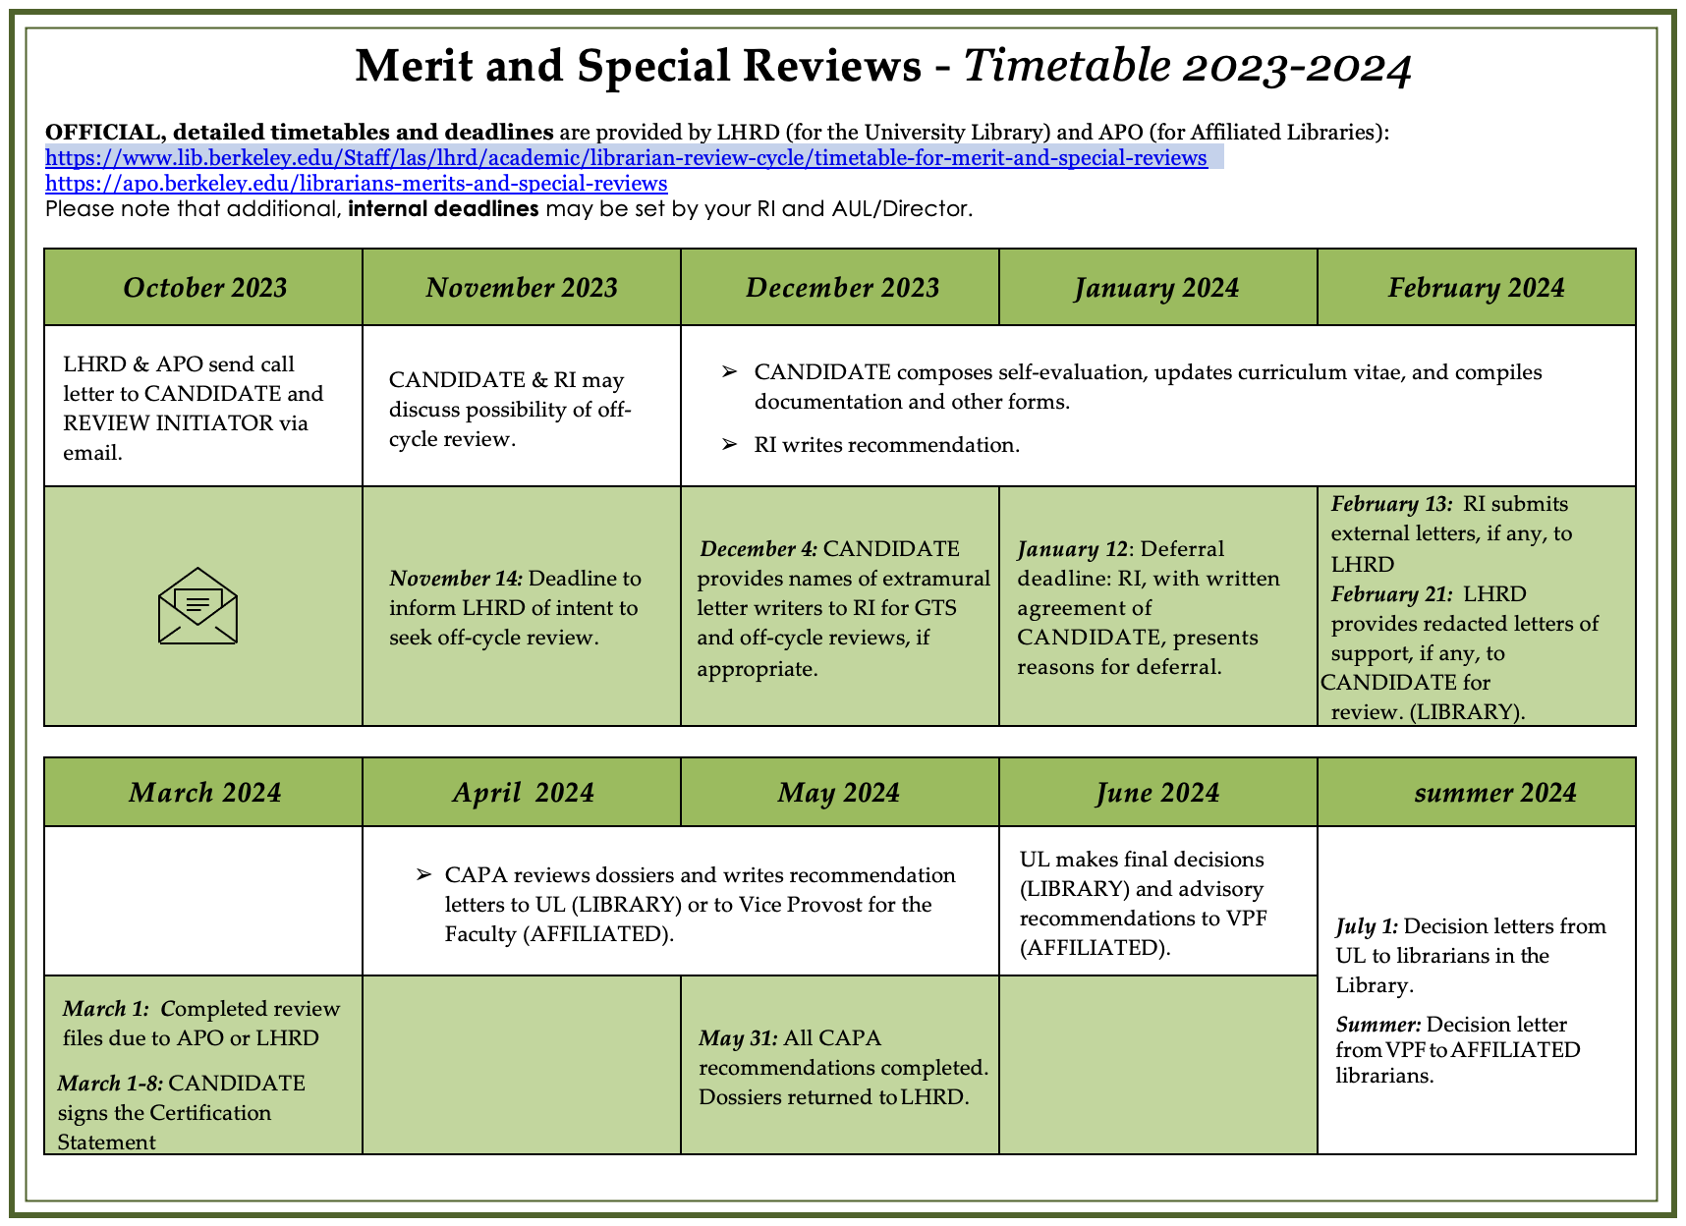

Slide 24
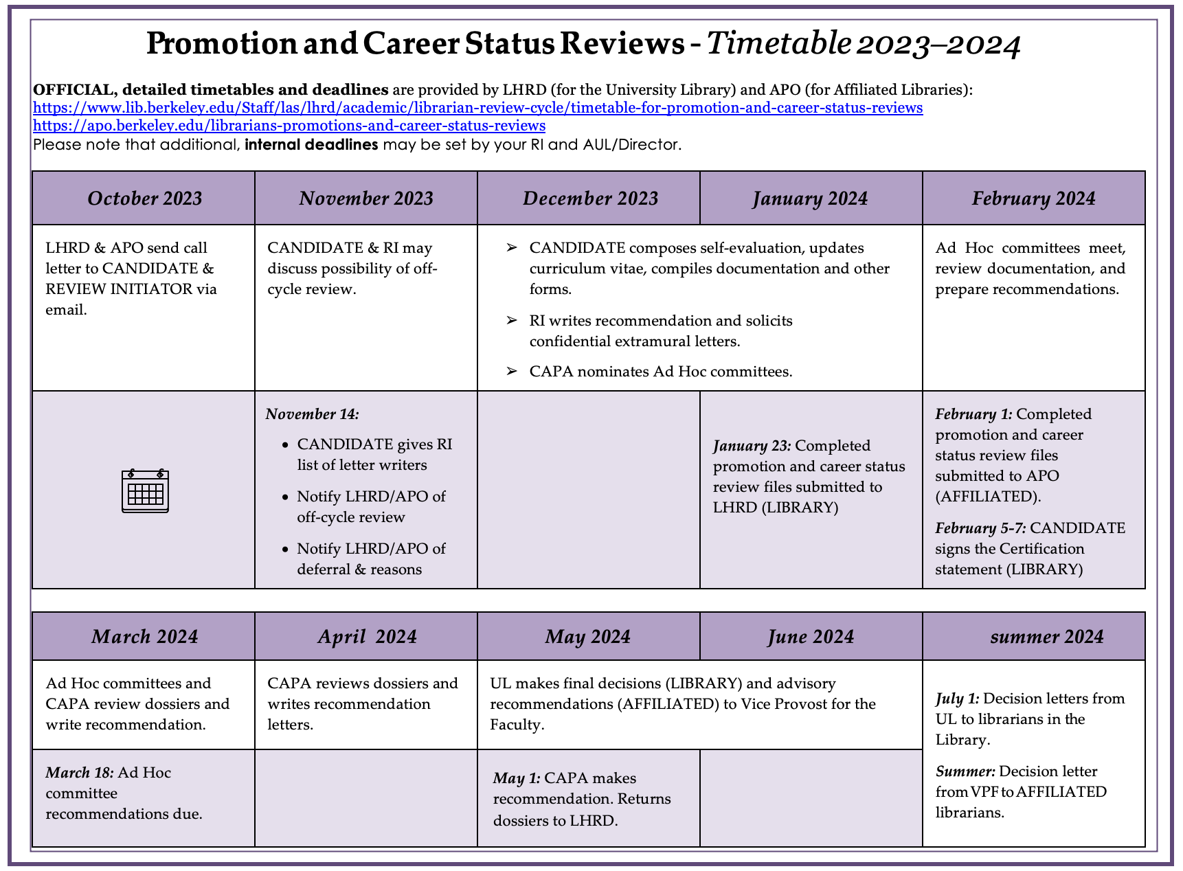

Slide 27
Where to go for help
Review Initiator
LAUC-B mentor (Contact LAUC-B mentor program coordinator Jennifer Brown if you’d like a mentor)
Former CAPA members (listed on CAPA section of the LAUC-B site)
LHRD/APO
The Guidelines
LAUC-B Librarian Review page: http://ucblib.link/lauc-b_librarian_review

Slide 28
After the Review
Make sure you get a copy of your dossier (with CAPA letter, any redacted letters, etc.)
Consider sharing your CAPA letter with your RI
No action
Reconsideration

Slide 29
Want to be a part of the process?
Volunteering for an Ad hoc committee
Must have career status
Team of 3 who review 1-3 career status / promotion cases
Ad hoc committee appointments are made in January
Work completed by late March
Volunteering for CAPA
Must have career status
Must hold Associate Librarian or full Librarian rank
Service on at least one Ad hoc committee preferred
CAPA appointments are made in the Fall
Most intensive period of service is January-May
CAPA strives to balance librarian work experience with committee needs. If you don’t get onto CAPA, ask again!
If interested, contact any CAPA member or respond to the call.

Slide 30
Thank you for attending! We’re here for your questions

Slide 31
Closing Remarks from University Librarian Jeff MacKie-Mason
Notes:
Do we still need this slide?

