Slide 1
Student Tech Helpdesk - Moffitt
Making Effective Referrals Meeting October 12th, 2016

Slide 2
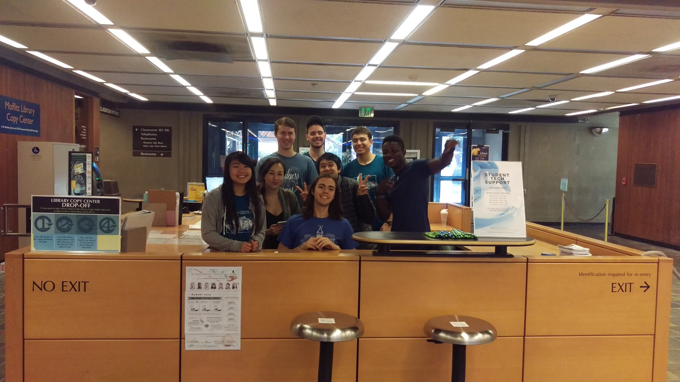
Welcome!

Slide 3
Student Tech Helpdesk
Launched August 2016 at Moffitt 3rd Floor
Replaced ETS Student Computer Consulting Service
Major component of Student Computing @ Cal Project
Staffed by student employees from ResComp (a program of Student Affairs IT)
Open 11am-3pm Mon-Sat., 1-3pm Sundays
Will move to renovated 4th Floor November 2016
Notes:
Expands helpdesk support to all undergraduate and graduate students. Previously this support was available only to students who lived in campus housing.

Slide 4
Student Computing @ Cal Project
Library | Student Affairs IT | IST | ETS | CSS-IT partnership
Three major project components:
Campuswide student helpdesk providing tech support to the entire student population
Unified computing lab experience including “look and feel” and standard software, hardware, and printing services
Outreach and communications efforts to help students navigate the technology resources available to them on campus
Project website coming soon to technology.berkeley.edu
Notes:
Supported by the Student Technology Fund

Slide 6
Student Computing for Cal Students
Tech Helpdesk
Student computing labs on campus & in residence halls
Department|School|College-specific computing labs
Makerspaces & innovation/design centers
Software downloads
DeCALs (1-2 unit student-led courses)
Clubs & student organizations
Laptop & iClicker checkout programs
Academic support and tech diversity programs
Notes:
The walk-up helpdesk is just one of many student computing services available to students. While there are many resources available, many students are unaware of them. One of the goals of the Student Computing @ Cal project is to increase awareness and use of these services & resources.

Slide 7
Primary Tech Issues Addressed
Connecting personal devices to campus network
Security vulnerabilities
Hardware failures
Software downloads
Connecting to Library proxy service

Slide 8
Future Directions
More hours of staff coverage
Additional central campus location - possibly Student Union
Leveraging CSS-IT systems (e.g., phone, after-hours support)
Rebranding by next year to merge ResComp and Student Tech Helpdesk into a single program with new name
Increased communications and outreach
More cross-training with Library, CSS-IT, ETS student staff

Slide 9
Things to Remember
Tech help for students’ personal devices UPSTAIRS
Computing Lab, Printers, Makerspace DOWNSTAIRS
Other locations available too (all are published online)
http://rescomp.berkeley.edu
Staffed 11am-3pm daily except Sundays 1pm-3pm
Phone support available Mon-Fri 9am-6pm (642-4357)

Slide 10
RESCOMP.BERKELEY.EDU
Notes:
Questions?

