Slide 1
Student Supervisors
Timecard Transfers, Affinity Groups, and Student Requisition

Slide 2
Training topics
Affinity Group specifics
Friendly Names
New automated student requisition and posting of positions
Review student employment policies
New process for transfers in CalTime
Library Administrative Services ǀ August 2014

Slide 3
Affinity Groups
15838AHUM | 15823EDU | 15864ACCESS | 15935INSTRUCT | 15977ENGIP | 15995LIFE | 15944SOCIAL
15953MUS |  | 15827PRIV | 15932MRC | 15971CHEM | 15991PUBL | 15835HUM
15945AHCS |  | 15865DMCS |  | 15972EART | 15970BIOS | 15836DATA
15828MORR |  | 15866MSTA |  | 15973ENGI | 15990OPTO | 15945ANTH
15829SSEA |  | 15867DMRM |  | 15974MATH |  | 15946EDP
15830AREA |  | 15868MOFC |  | 15976PHYS |  | 15948BUSI
15831GRAD |  | 15870PNM |  |  |  | 15947ENVI
Library Administrative Services ǀ August 2014

Slide 4
Friendly Names
Friendly names are unique codes used in CalTime to identify each student’s timecard supervisor and unit and track hours worked.
Friendly Names include a location code and the timecard supervisor’s last name.
…
Examples:
LIB-MUS-ARNOLD
LIB-MORR-PETERSON
LIB-ANTH-LEE
Library Administrative Services ǀ August 2014

Slide 5
Hiring Students
NEW Library Student Requisition Form!
Login with your CalNet ID
Submit to HR
Job posted online!
Library Administrative Services ǀ August 2014

Slide 6
State Regulations & Work Time
After three hours worked, a student is eligible for a 15 minute break at department’s discretion. Breaks cannot be accumulated or used for other purposes, such as leaving work early or adjusting work schedules.
If a student works a shift 5.75 hours or longer, the student must clock out for a 30 minute lunch break. If the student does not clock out for lunch, CalTime will automatically deduct this time after 5.75 hours due to state law.
If student does work through lunch, the department is legally obligated to pay for time worked.
Library Administrative Services ǀ August 2014

Slide 7
Shared Appointments & Overtime
It’s the student’s responsibility to inform his or her immediate supervisor if the student is employed in more than one University appointment.
Student employees may be scheduled to work up to a maximum of 49% of the working hours in the month (an average of 19.50 hrs per week.) If they exceed the 49%, it may generate overtime.*
*If you have any questions regarding overtime, you can contact Campus Shared Services at berkeley.service-now.com and create a ticket.
Library Administrative Services ǀ August 2014

Slide 8
DCP: Defined Contribution Plan
Students who do not meet exemption criteria will be required to contribute 1.45% of their gross earnings to Medicare and 7.5% of their gross earnings to the Defined Contribution plan (DCP), a tax-deferred University retirement program which is an alternative to OASDI (Social Security).
The DCP contributions remain the property of the student from whom they are withheld. Contributions are made on a pre-tax basis, which reduces the student’s tax liability for the year in which the contributions are made. Taxes on the contributions and any earnings are deferred until the employee withdraws the money, which can occur upon termination of UC employment. As the DCP is a retirement plan, special rules, such as possible penalties for early withdrawal of accumulations, do apply.
When students stop working for the University completely, they should contact Fidelity at 1-800-343-3548 for options regarding distributions and rollovers.
Library Administrative Services ǀ August 2014

Slide 9
Student Separations
When a separation request is submitted, the student’s file is passed from HR to Campus Shared Services. Payment for any unpaid hours will be ordered on the next available pay cycle. For this reason, it is important to approve the separating students’ timecards promptly so that they will receive their final pay check as soon as possible.
Students will automatically receive their final payment as a direct deposit.
ID ‘S’s and separation time
Library Administrative Services ǀ August 2014

Slide 10
Work-Study
In addition to monitoring students’ timecards every month, it is important to keep track of their Work-Study funds. For this reason, HR prepares a monthly report to send to Timecard Supervisors. The report includes each student’s Work-Study balance after the most recent pay period.
Library Administrative Services ǀ August 2014

Slide 11
Work-Study Report
Remaining Award = Work-Study Award – Last Reported
4000 .00
– 1466.35
$2533.65
of work-study funds remaining
Library Administrative Services ǀ August 2014

Slide 12
Work-Study
Each student employee’s remaining award is calculated based on the information provided by the Work-Study website after each pay cycle.
Work-Study funds cover 50% of student earnings
Library Administrative Services ǀ August 2014

Slide 13
Managing Timecards
CALTIME REMINDERS
All Home and Transferred-in allows you to see all of your student employees
When you go to approve students’ timecards, select Previous Pay Period.
Review each student’s timecard individually to confirm the hours worked.
Library Administrative Services ǀ August 2014

Slide 14
Pay Period Close
Student Pay Periods are bi-weekly:
Sunday to Saturday,
e.g. October 9th- 22nd, 2016
You will receive an email reminder at the end of the Pay Period.
Approve timecards!
Library Administrative Services ǀ August 2014

Slide 15
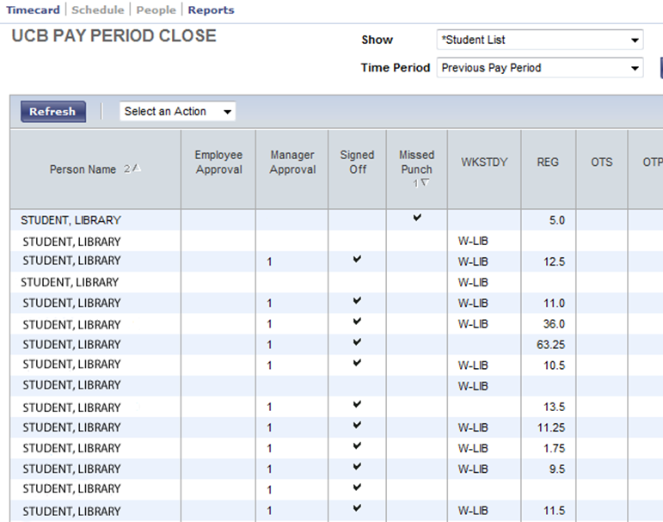
Missing Punches
Before applying your approval to your students’ timecards, check for missing punches to ensure students are paid accurately for time worked.
You will be sent reminder emails if you have not entered missing punches by the designated approval deadline.
The Missed Punch column in the Pay Period Close Genie is particularly helpful in locating missing punches.
Library Administrative Services ǀ August 2014

Slide 16
MISSING PUNCH!
Library Administrative Services ǀ August 2014

Slide 17
Transfers
WORKLEADER TRANSFER
Previously, the workleader rate was entered by changing the single digit number at the end of the chart string (LL7)
4922/151029/19900/ORG.CODE/60/--/ 3
4922/151231/19900/ORG.CODE/60/--/ 1
4922/151029/19900/ORG.CODE/60/--/ 4
4922/151231/19900/ORG.CODE/60/--/ 2
WORK-STUDY
NO WORK-STUDY
Library Administrative Services ǀ August 2014

Slide 18
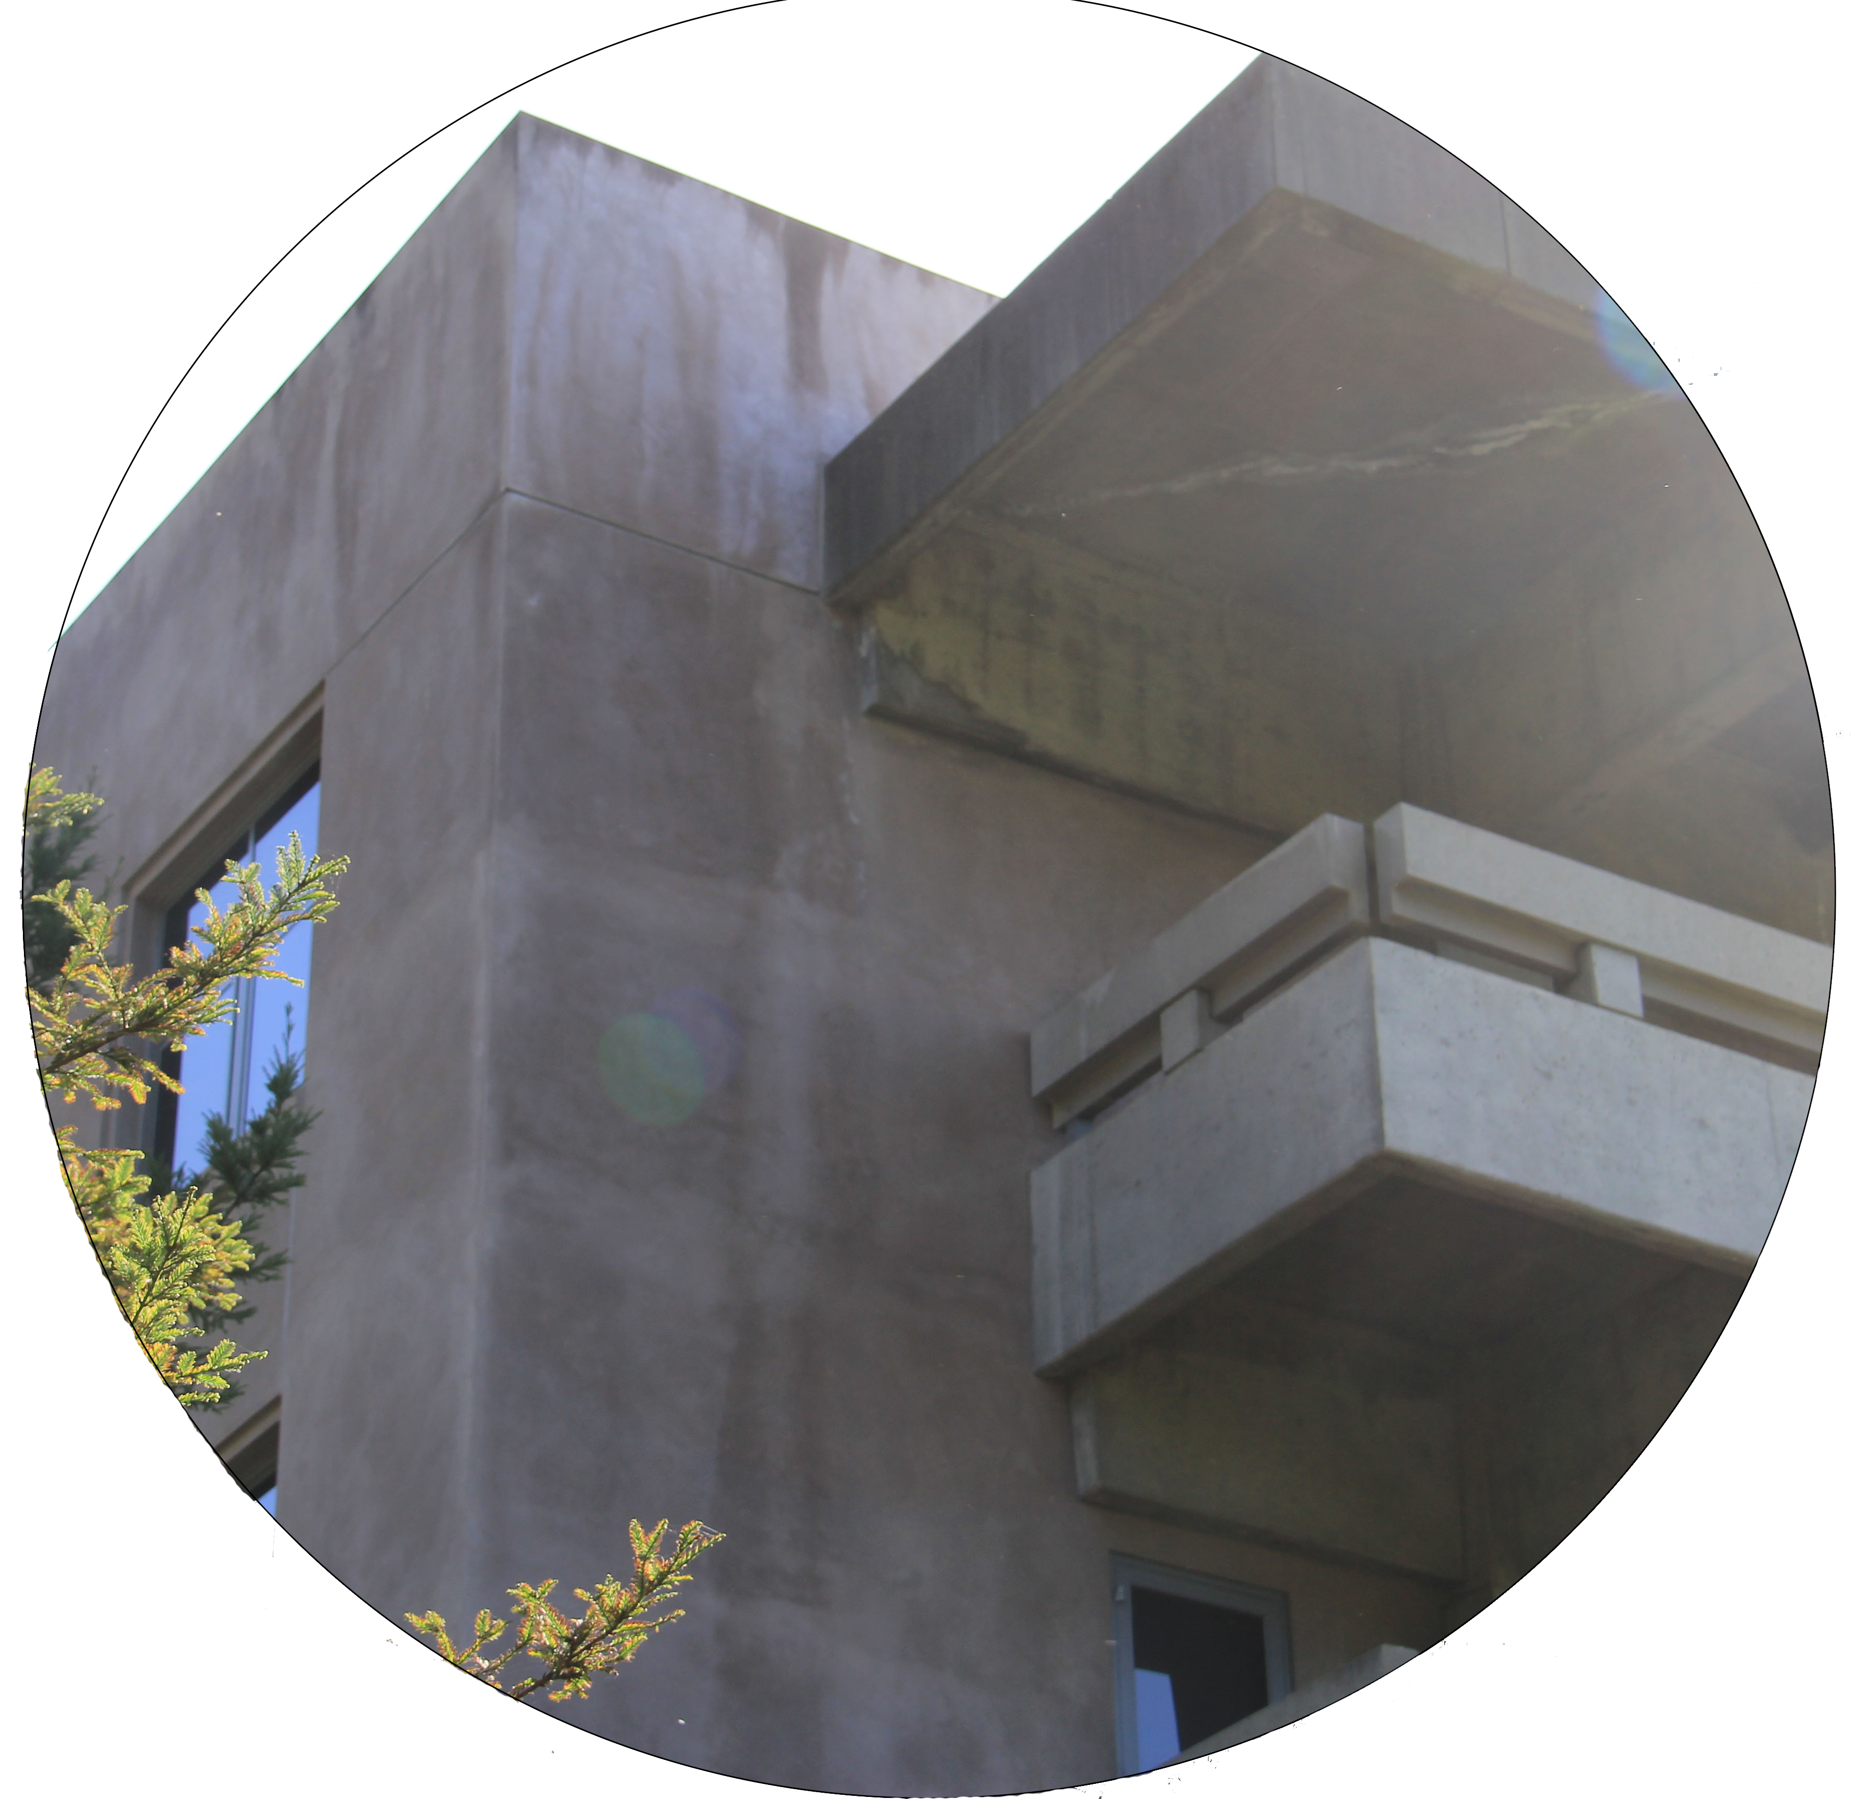
Transferring
If a student employee works for more than one library unit within the same affinity group, the student DOES NOT NEED TO TRANSFER.
If a student employee works for more than one library unit in different affinity groups or other units, the student MUST TRANSFER to the appropriate location when clocking in.
Moffitt Circulation
Main Stacks
Moffitt Circulation
East Asian Library
Library Administrative Services ǀ August 2014

Slide 19
Sorting by Manager
Multiple managers!
Library Administrative Services ǀ August 2014

Slide 20
Library Administrative Services ǀ August 2014

Slide 21
Library Administrative Services ǀ August 2014

Slide 22
Questions?
libpay@lists.berkeley.edu
OR
Campus Shared Services
http://berkeley.service-now.com
Library Administrative Services ǀ August 2014

